Slide 1
Welcome to Microsoft Defender Day 1

Slide 2
A look into Day 1
Kick-Off | 8:00-8:05 | Welcome | Main Call
 | 8:05-8:30 | Microsoft 365 Defender / Microsoft Defender for Endpoint
 | 8:30-8:45 | Demo Walkthrough
Ingest | 8:45-9:00 | Break
 | 9:00-10:00 | Microsoft Defender for EndPoint, Microsoft Antivirus
 | 10:00-10:30 | Activity: Microsoft Defender | Table Group Call
 | 10:30-10:45 | Break
 | 10:45-12:00 | Build Hands-on: Microsoft Defender Onboarding | Table Group Call
Transform | 12:00-1:00 | Break | Main Call
 | 1:00-1:30 | Microsoft Defender Portal
 | 1:30-2:00 | Activity: Microsoft Defender
 | 2:00-4:00 | Build Hands-on: Microsoft Defender Portal | Table Group Call
 | 4:00-4:15 | Closing | Main Call
Today we will be learning and collaborating across three spaces:
Main call (this meeting)
Table Group channel within the event Team
CloudLabs Learner Portal & Lab environment
Presentation/
Whole Group
Lab
Activity/ Discussion/ Group Work
Announcements

Slide 3
Pre-requisites
AZ-500 - Microsoft Azure Security Technologies
https://query.prod.cms.rt.microsoft.com/cms/api/am/binary/RE3VC70
SC-200 - Microsoft Security Operations Analyst
https://query.prod.cms.rt.microsoft.com/cms/api/am/binary/RE4Myp3

Slide 4
Microsoft Defender

Slide 5
Microsoft 365 Defender

Slide 6

Microsoft 365 Defender
A unified pre- and post-breach enterprise defense suite. It natively coordinates detection, prevention, investigation, and response across endpoints, identities, email, and applications to provide integrated protection against sophisticated attacks.
Microsoft 365 Defender combines the capabilities of the following into a single solution:
Microsoft Defender for Endpoint (formerly Microsoft Defender ATP)
Microsoft Defender for Identity (formerly Azure ATP)
Microsoft Defender for Office 365 (formerly Office 365 ATP)
Azure Active Directory Identity Protection
Microsoft Cloud App Security
On July 6th 2021 :
https://securitycenter.microsoft.com/reports => https://security.microsoft.com

Slide 7
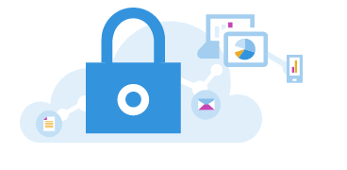
Portal Integration
Microsoft 365 Defender (https://security.microsoft.com) combines protection, detection, investigation, and response to email, collaboration, identity, and device threats, in a central portal.
All the security content that you use in the Office 365 Security and Compliance Center (protection.office.com) and the Microsoft Defender security center (securitycenter.microsoft.com) can now be found in the Microsoft 365 Defender.
Microsoft 365 Defender emphasizes unity, clarity, and common goals as it merges Microsoft Defender for Office 365 and Microsoft Defender for Endpoint. The merge was based on the priorities listed below, and made without sacrificing the capabilities that each security suite brought to the combination of:
Common building blocks
Common terminology
Common entities
Feature parity with other workloads

Slide 8
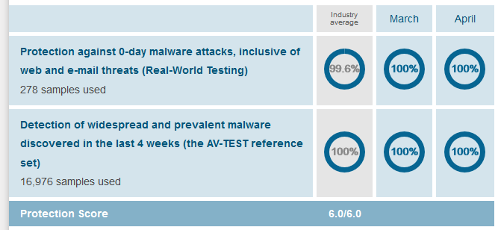
Top Scoring
Consistently achieve high scores in independent tests.
MITRE ATT&CK
Microsoft 365 Defender provided nearly 100 percent coverage across the attack chain stages
Delivered leading out-of-box visibility into attacker activities, dramatically reducing manual work for SOCs vs. vendor solutions that relied on specific configuration changes.
Delivered automated real-time alerts without the need for configuration changes or custom detections; Microsoft is one of only three vendors who did not make configuration changes or rely on delayed detections.
Flagged more than 80 distinct alerts, and used built-in automation to correlate these alerts into only two incidents that mirrored the two MITRE ATT&CK simulations, improving SOC analyst efficiency and reducing attacker dwell time and ability to persist.
Identified seven distinct steps during the attack in which our protection features, which were disabled during testing, would have automatically intervened to stop the attack.
AV-TEST - Protection score of 6.0/6.0
AV-Comparatives - Protection rating of 99.8%
SE Labs - AAA award
Notes:
Microsoft Threat Protection leads in real-world detection in MITRE ATT&CK evaluation - Microsoft Security
Top scoring in industry tests - Microsoft 365 Defender | Microsoft Docs

Slide 9
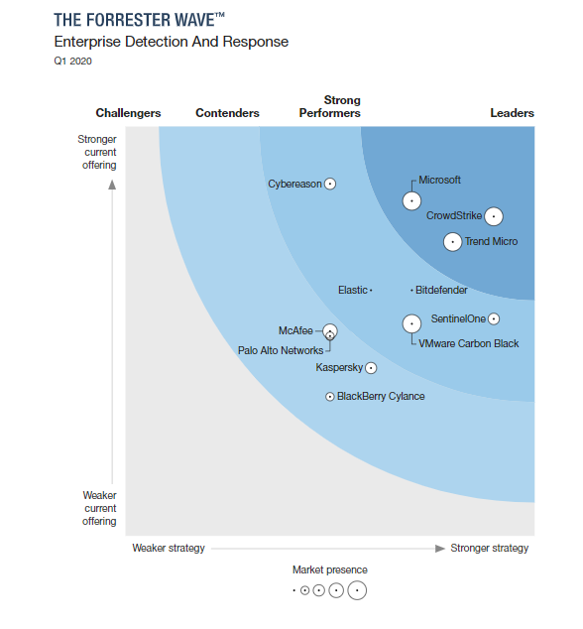
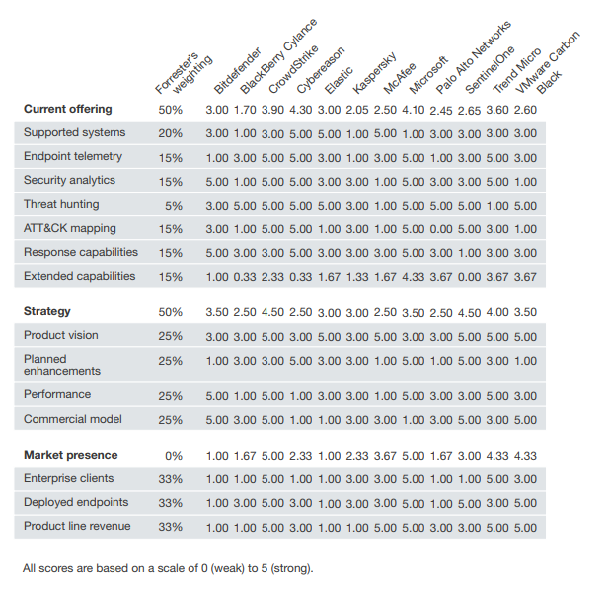
Forrester
Microsoft Defender recognized as a Leader in Enterprise Detection and Response
Notes:
Microsoft Threat Protection leads in real-world detection in MITRE ATT&CK evaluation - Microsoft Security

Slide 10
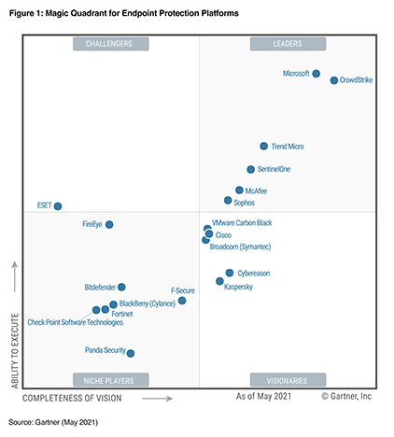
Gartner
Microsoft Defender recognized as a Leader & Visionary in Enterprise Detection and Response
Microsoft Defender for Endpoint (MDE) provides an integrated and comprehensive set of EPP, EDR and threat hunting capabilities from a single cloud-hosted console and data lake.
The native protection and prevention provided by Defender Antivirus in Windows OS is widely used and popular with customers, and is also leveraged by other vendors in this Magic Quadrant.
Notes:
Microsoft Threat Protection leads in real-world detection in MITRE ATT&CK evaluation - Microsoft Security

Slide 11

NOTE: Simulated vs Real World Testing
Isolating Antivirus from the rest of the Microsoft Defender stack discounts the synergy among components and creates conditions that don’t reflect the real world.
Size Factor : Windows Defender AV encounters a staggering ~200 million samples every month, 96% of which are polymorphic.
Synthetic conditions factor : Synthetically emulating real-world infection often discounts contextual and behavioral clues that normally accompany malware infections in the real world. Such clues are important for behavioral detections and their absence can reduce the effectiveness of security solutions.
Isolation factor : Isolating AV also discounts the synergy with other protection components in real enterprise networks. The Microsoft Defender stack includes components like endpoint detection and response (EDR) capabilities, Microsoft Defender SmartScreen, Microsoft Defender Exploit Guard, and others.
Notes:
https://query.prod.cms.rt.microsoft.com/cms/api/am/binary/RE2ouJA

Slide 12
Microsoft’s Take: Areas that matter most
Frequency of action : Most users in enterprise environments are information workers whose common user activities include:
Browsing the web
Using email clients
Processing documents
Accessing network resource
Users spend substantially less time installing new applications compared with the activities listed
above. This is true for all user segments, but it is especially true for enterprise users where
software installation is usually governed by usage policies.
Microsoft Defender performance is optimized for delivering high levels of performance in high frequency actions for better overall user experience.
Notes:
https://query.prod.cms.rt.microsoft.com/cms/api/am/binary/RE2ouJA

Slide 13
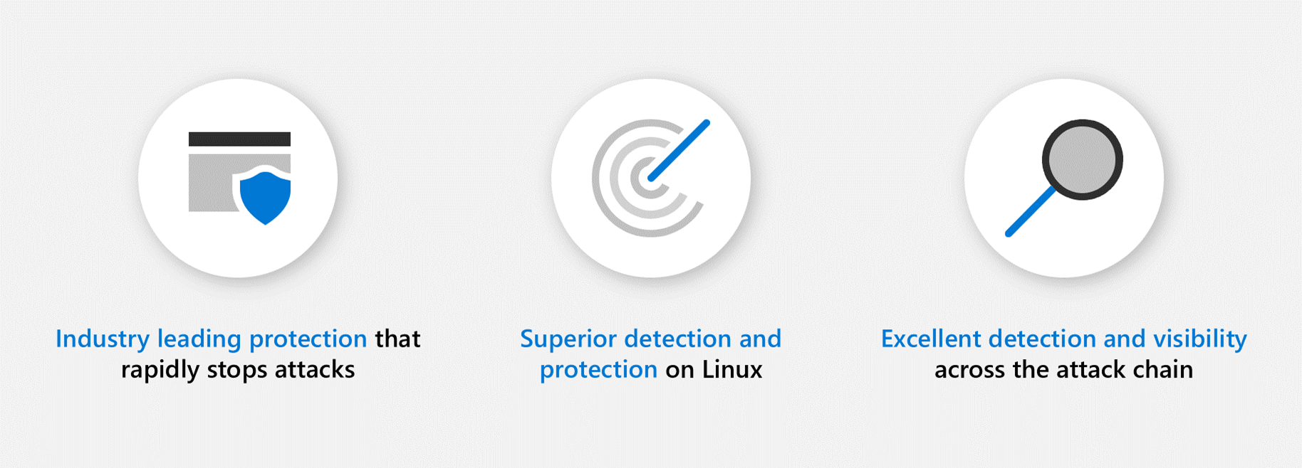
Net Net: Consistent Results
Industry-leading protection: Microsoft’s industry-leading capabilities quickly identified suspicious activity and offered real-time containment to rapidly stop the attack.
Superior detection and protection on Linux: Microsoft Defender for Endpoint blocked everything on Linux, providing exceptional detection, protection, and visibility that comprehensively captured Linux file server activity.
Excellent detection and visibility across the attack chain: Our world-class SecOps experience and Microsoft 365 Defender capabilities showed the full attack story across domains and quickly correlated all activity down to two incidents.

Slide 14
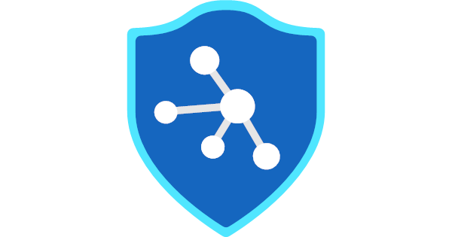

Microsoft Defender + Azure Defender + Azure Sentinel
The combination of Microsoft Defender Endpoint protection, plus Azure Defender control plane protection combined with Azure Sentinel hunting abilities provide for a single pane of glass that is a very powerful solution for customers.
Customer’s will ask you how to protect not just their Azure Portal, but also the devices that run inside them and how it all works with on-premises devices.
Attackers don’t care where the device is running, an integrated hybrid network will still allow for lateral movement from on-premises to Azure and vice versa.

Slide 15
How They Work Together
Microsoft Defender utilizes Log Analytics for log data collection and analysis. The backing Log Analytics instance is not surfaced in a client’s Azure subscription/tenant
Azure Defender utilizes Log Analytics for log data collection and analysis, this instance is surfaced in Azure Portal.
Both use the same Log Analytics agent (Microsoft Monitoring Agent) for logging. Agent can be configured to send logs to more than one Log Analytics workspace and can run on-premises or across clouds.
Microsoft Defender for Endpoint can be installed in a customer’s Azure Compute as well as on-premises compute infrastructure. The combination provides a high effective solution for protecting Azure resources.
Explore the Art of the Possible!

Slide 16
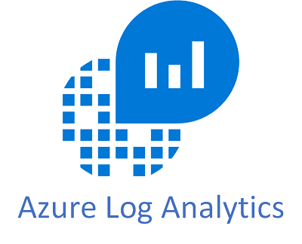
All roads lead to Log Analytics and Azure Sentinel.
Azure Sentinel provides the linkage to allow for data in Microsoft Defender to be replicated to the Azure exposed Log Analytics workspace for a full picture of an organization's security and logging landscape.
A single workspace allows for more in-depth analysis across entities and relationships between them.

Slide 17
Thank You slide
Break (15 mins)

Slide 18
Welcome Back!
8:00-8:05 | Welcome
8:05-8:30 | Microsoft 365 Defender / Microsoft Defender for Endpoint
8:30-8:45 | Demo Walkthrough
8:45-9:00 | Break
9:00-10:00 | Microsoft Defender for EndPoint, Microsoft Antivirus
10:00-10:30 | Activity: Microsoft Defender | Table Group Call
10:30-10:45 | Break
10:45-12:00 | Build Hands-on: Microsoft Defender Onboarding | Table Group Call
12:00-1:00 | Long Break | Main Call
1:00-1:30 | Microsoft Defender Portal
1:30-2:00 | Activity: Microsoft Defender | Table Group Call
2:00-4:00 | Build Hands-on: Microsoft Defender Portal
4:00-4:15 | Closing | Main Call
Presentation/
Whole Group
Lab
Activity/ Discussion/ Group Work
Announcements

Slide 19
Microsoft Defender for Endpoint

Slide 20
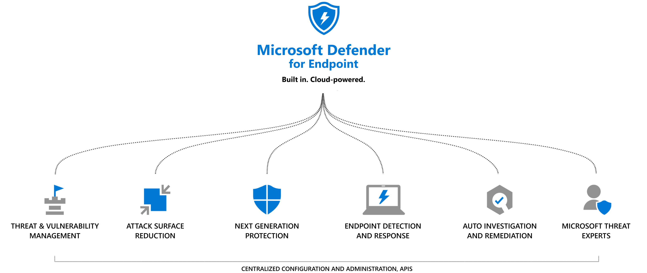
Microsoft Defender for Endpoint
Microsoft Defender for Endpoint (also known as Microsoft Defender Advanced Threat Protection) is a holistic, cloud-delivered endpoint security solution that provides advanced attack detections that are near real-time and actionable.
Security analysts can prioritize alerts effectively, gain visibility into the full scope of a breach, and take response actions to remediate threats.

Slide 21
Microsoft Defender for Endpoint
Next Generation Protection Engines

Slide 22

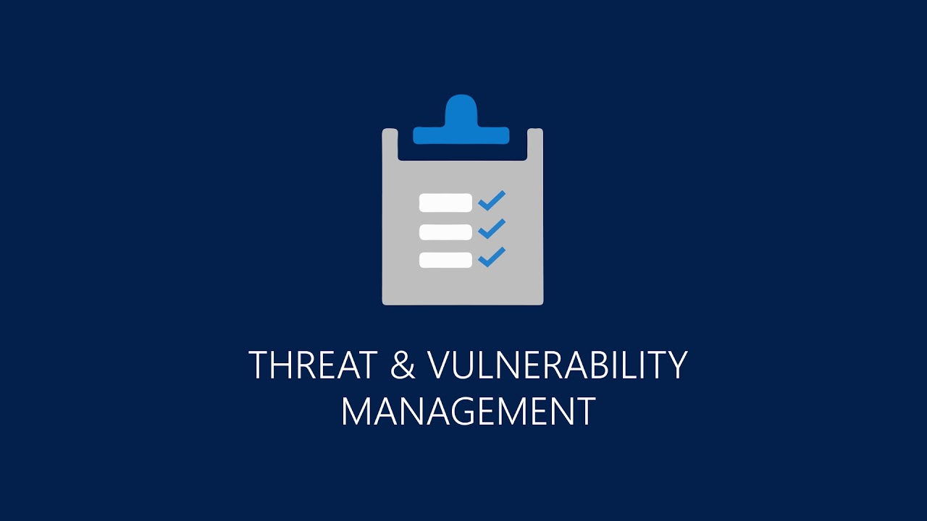
Threat & Vulnerability Management
Component that helps effectively identify, assess, and remediate endpoint weaknesses. A risk-based approach to the discovery, prioritization, and remediation of endpoint vulnerabilities and misconfigurations.
Real-time endpoint detection and response (EDR) insights correlated with endpoint vulnerabilities
Invaluable machine vulnerability context during incident investigations
Built-in remediation processes through Microsoft Intune and Microsoft System Center Configuration Manager
Notes:
Threat & Vulnerability Management now publicly available! - Microsoft Tech Community

Slide 23
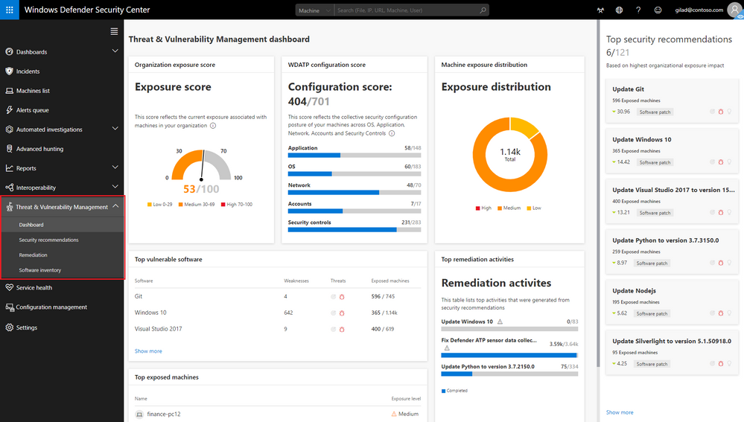
Threat & Vulnerability Management
Notes:
https://docs.microsoft.com/en-us/microsoft-365/security/defender-endpoint/onboard-configure?view=o365-worldwide

Slide 24

Attack Surface Reduction (ASR)
Reduce vulnerabilities (attack surfaces) in your applications with intelligent rules that help stop malware.
Protect and maintain the integrity of a system as it starts and while it's running. Validate system integrity through local and remote attestation. Use container isolation for Microsoft Edge to help guard against malicious websites.
Use application control so that your applications must earn trust in order to run.
Help protect operating systems and apps your organization uses from being exploited.
Extend protection to your network traffic and connectivity on your organization's devices.
Secure your devices against web threats and help you regulate unwanted content.
Help prevent malicious or suspicious apps (including file-encrypting ransomware malware) from making changes to files in your key system folders
Prevent unauthorized traffic from flowing to or from your organization's devices with two-way network traffic filtering.
Notes:
Overview of attack surface reduction | Microsoft Docs
Attack surface reduction frequently asked questions (FAQ) | Microsoft Docs

Slide 25
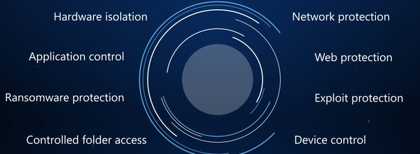
Attack Surface Reduction (ASR)
Notes:
Hardware-based isolationProtect and maintain the integrity of a system as it starts and while it's running. Validate system integrity through local and remote attestation. And, use container isolation for Microsoft Edge to help guard against malicious websites.
Application controlUse application control so that your applications must earn trust in order to run.
Controlled folder accessHelp prevent malicious or suspicious apps (including file-encrypting ransomware malware) from making changes to files in your key system folders (Requires Microsoft Defender Antivirus)
Network protectionExtend protection to your network traffic and connectivity on your organization's devices. (Requires Microsoft Defender Antivirus)
Exploit protectionHelp protect operating systems and apps your organization uses from being exploited. Exploit protection also works with third-party antivirus solutions.
Attack surface reduction rulesReduce vulnerabilities (attack surfaces) in your applications with intelligent rules that help stop malware. (Requires Microsoft Defender Antivirus).
Device controlProtects against data loss by monitoring and controlling media used on devices, such as removable storage and USB drives, in your organization.

Slide 26

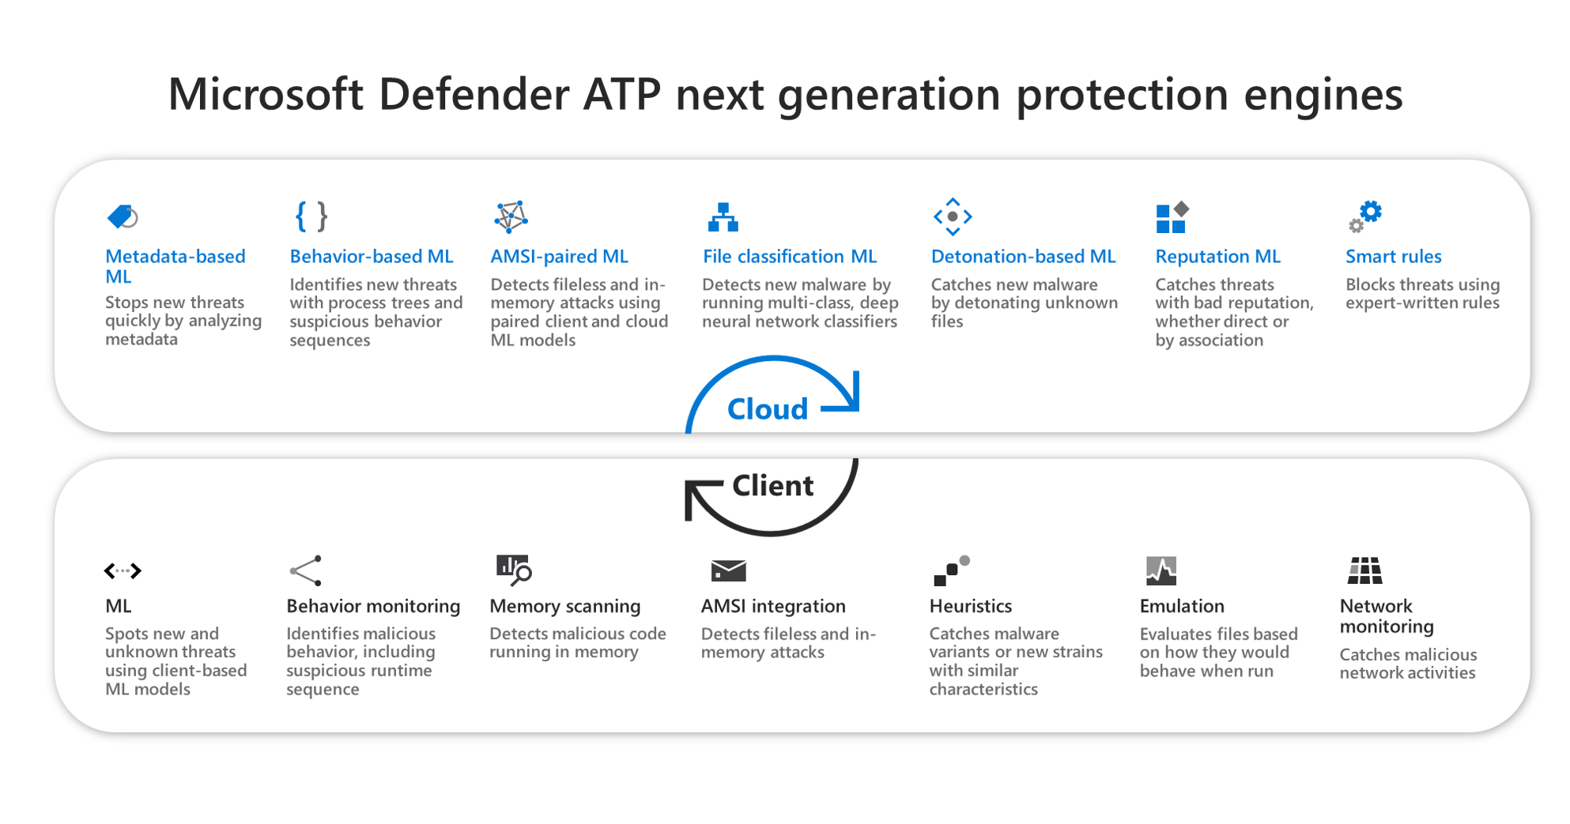
Next Generation Protection
Notes:
https://docs.microsoft.com/en-us/microsoft-365/security/defender-endpoint/onboard-configure?view=o365-worldwide

Slide 27
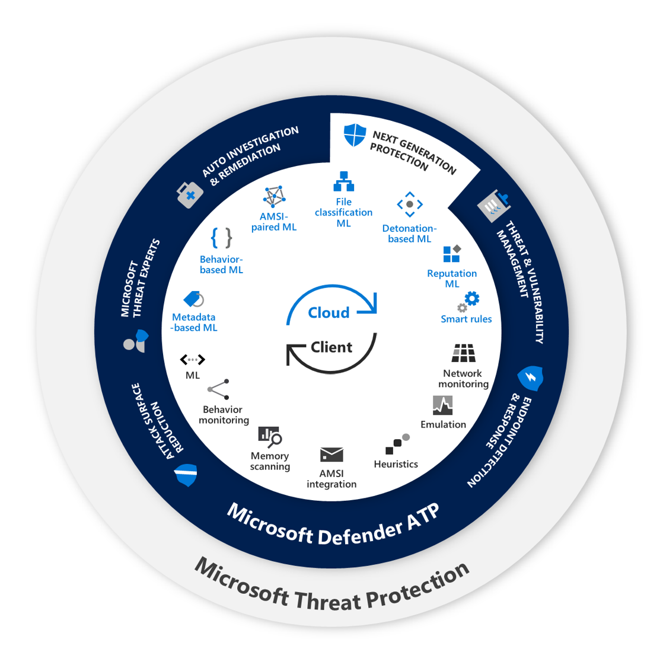
Next Generation Protection
Metadata-based ML engine – Specialized ML models, which include file type-specific models, feature-specific models, and adversary-hardened monotonic models, analyze a featurized description of suspicious files sent by the client. Stacked ensemble classifiers combine results from these models to make a real-time verdict to allow or block files pre-execution.
Behavior-based ML engine – Suspicious behavior sequences and advanced attack techniques are monitored on the client as triggers to analyze the process tree behavior using real-time cloud ML models. Monitored attack techniques span the attack chain, from exploits, elevation, and persistence all the way through to lateral movement and exfiltration.
Notes:
Inside out: Get to know the advanced technologies at the core of Microsoft Defender ATP next generation protection - Microsoft Security

Slide 28
Next Generation Protection (Cont)
AMSI-paired ML engine – Pairs of client-side and cloud-side models perform advanced analysis of scripting behavior pre- and post-execution to catch advanced threats like fileless and in-memory attacks. These models include a pair of models for each of the scripting engines covered, including PowerShell, JavaScript, VBScript, and Office VBA macros. Integrations include both dynamic content calls and/or behavior instrumentation on the scripting engines.
File classification ML engine – Multi-class, deep neural network classifiers examine full file contents, provides an additional layer of defense against attacks that require additional analysis. Suspicious files are held from running and submitted to the cloud protection service for classification. Within seconds, full-content deep learning models produce a classification and reply to the client to allow or block the file.
Detonation-based ML engine – Suspicious files are detonated in a sandbox. Deep learning classifiers analyze the observed behaviors to block attacks.
Reputation ML engine – Domain-expert reputation sources and models from across Microsoft are queried to block threats that are linked to malicious or suspicious URLs, domains, emails, and files. Sources include Windows Defender SmartScreen for URL reputation models and Office 365 ATP for email attachment expert knowledge, among other Microsoft services through the Microsoft Intelligent Security Graph.
Smart rules engine – Expert-written smart rules identify threats based on researcher expertise and collective knowledge of threats.
Notes:
Inside out: Get to know the advanced technologies at the core of Microsoft Defender ATP next generation protection - Microsoft Security

Slide 29
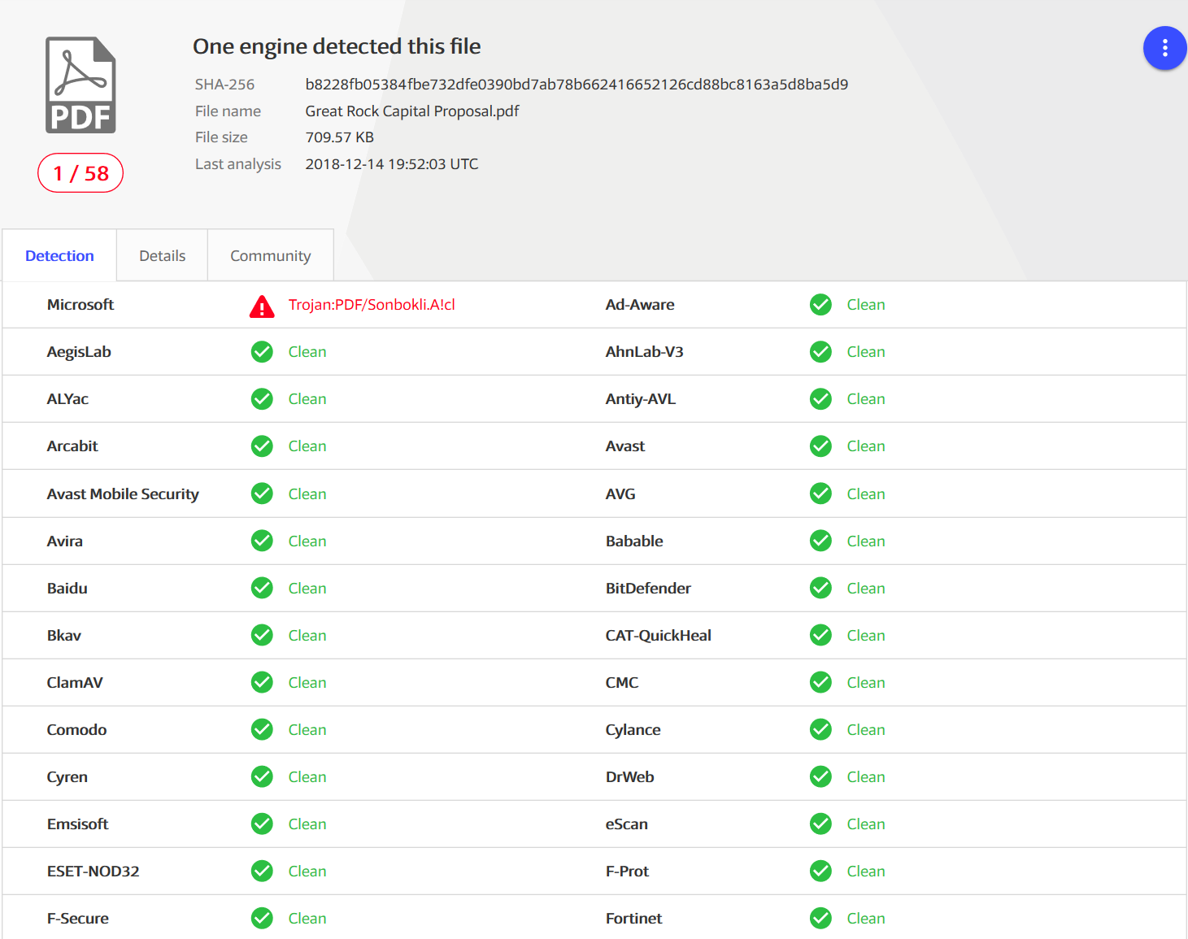
Next Generation Protection – Real World
Notes:
Recently, anomaly detection algorithms in the Windows Defender ATP next-generation protection pointed to multiple PDF files that only Microsoft detects. These malicious PDF files were blocked by machine learning models that assimilate signals from other components of our protection stack, exemplifying how comprehensive telemetry, signal-sharing, and machine learning allows Microsoft to deliver best-in-class security.
Tackling phishing with signal-sharing and machine learning - Microsoft Security

Slide 30
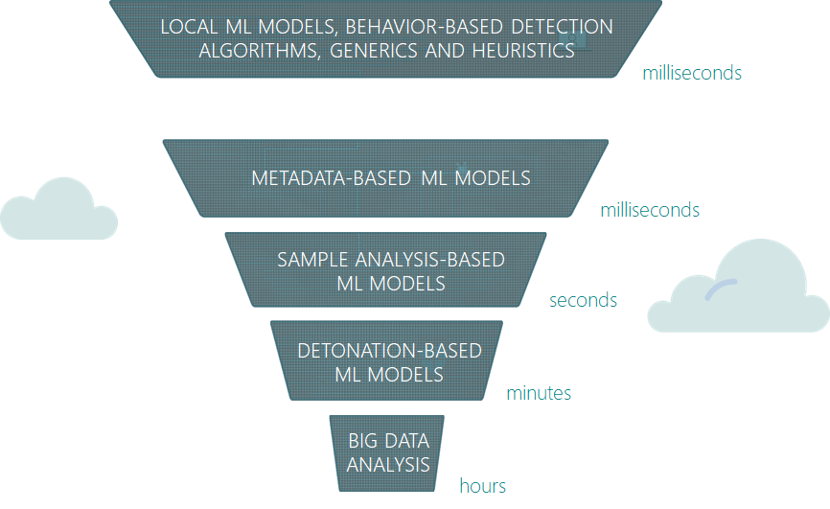
Next Generation Protection – Machine Learning
Notes:
Windows Defender ATP uses multiple layers of machine learning models to correctly identify malicious content. Most attacks are caught by the first few layers, which swiftly make a verdict and protect customers at first sight during the early stages of attacks. More sophisticated attacks may need the more complex classifiers in further layers, which take more time but make sure additional protections catch attacks that evade the first, faster classifiers.
Tackling phishing with signal-sharing and machine learning - Microsoft Security

Slide 31
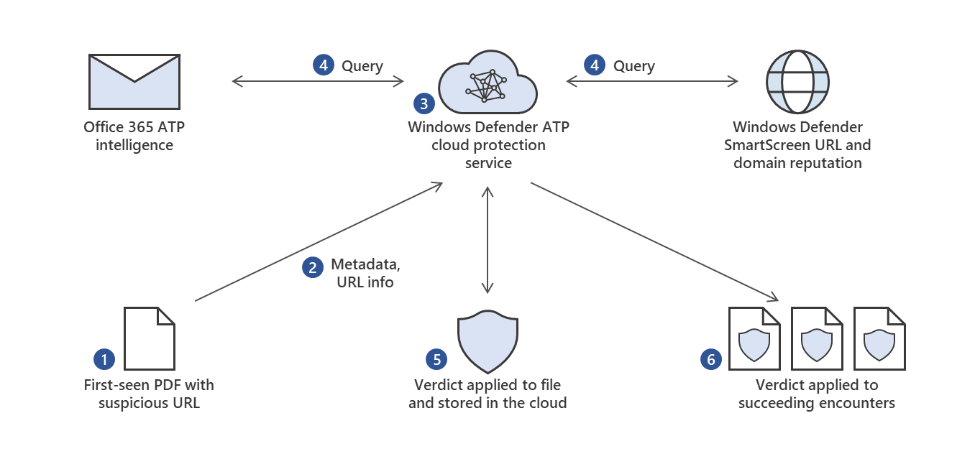
Next Generation Protection – How did it do it?
Notes:
Through the Microsoft Intelligent Security Graph, we enrich this detection algorithm with URL and domain reputation intelligence from Windows Defender SmartScreen, the technology that powers the anti-phishing technology in Microsoft Edge, as well as the Network protection capability in Windows Defender ATP.
Tackling phishing with signal-sharing and machine learning - Microsoft Security

Slide 32
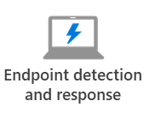
Endpoint Detection and Response (EDR)
EDR provides advanced attack detections that are near real-time and actionable. Security analysts can prioritize alerts effectively, gain visibility into the full scope of a breach, and take response actions to remediate threats.
When a threat is detected, alerts are created in the system for an analyst to investigate. Alerts with the same attack techniques or attributed to the same attacker are aggregated into an entity called an incident. Aggregating alerts in this manner makes it easy for analysts to collectively investigate and respond to threats.
Inspired by the "assume breach" mindset, Defender for Endpoint continuously collects behavioral cyber telemetry. This includes process information, network activities, deep optics into the kernel and memory manager, user login activities, registry and file system changes, and others.
The information is stored for six months, enabling an analyst to travel back in time to the start of an attack. The analyst can then pivot in various views and approach an investigation through multiple vectors.
Notes:
https://docs.microsoft.com/en-us/microsoft-365/security/defender-endpoint/onboard-configure?view=o365-worldwide

Slide 33
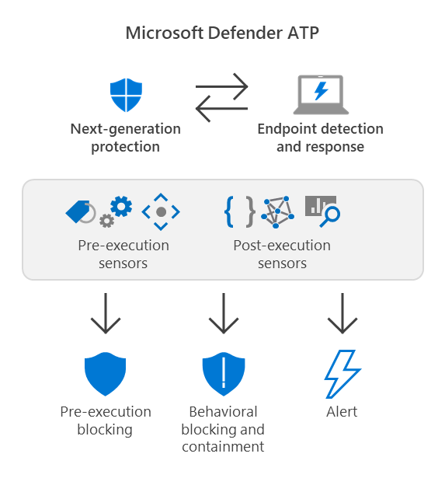
Next Generation + EDR
Notes:
https://docs.microsoft.com/en-us/microsoft-365/security/defender-endpoint/behavioral-blocking-containment?view=o365-worldwide
Next-generation protection (which includes Microsoft Defender Antivirus) can detect threats by analyzing behaviors, and stop threats that have started running.
Endpoint detection and response (EDR) receives security signals across your network, devices, and kernel behavior. As threats are detected, alerts are created. Multiple alerts of the same type are aggregated into incidents, which makes it easier for your security operations team to investigate and respond.
Malicious artifacts or behaviors that are observed through post-breach protection are blocked and contained. EDR in block mode works even if Microsoft Defender Antivirus is not the primary antivirus solution

Slide 34

Automated Investigation and Response (AIR)
AIR capabilities are designed to examine alerts and take immediate action to resolve breaches.
AIR capabilities significantly reduce alert volume, allowing security operations to focus on more sophisticated threats and other high-value initiatives.
All remediation actions, whether pending or completed, are tracked in the Action center. In the Action center, pending actions are approved (or rejected), and completed actions can be undone if needed.
While an investigation is running, any other alerts generated from the device are added to an ongoing automated investigation until that investigation is completed. In addition, if the same threat is seen on other devices, those devices are added to the investigation.
Notes:
Use automated investigations to investigate and remediate threats | Microsoft Docs

Slide 35
AIR - Automation Level
When automated investigation and remediation capabilities were first introduced, the default automation level was set to semi - require approval for any remediation.
Since then, we have increased our malware detection accuracy, added the option to undo remediation actions, and improved our automated investigation infrastructure.
Throughout this time, we have seen thousands of cases where organizations with fully automated tenants have successfully contained and remediated threats, while other companies, left with the default ‘semi’ level, have remained at high risk due to lengthy pending time for approval of actions.
Data collected and analyzed over the past year shows that organizations who are using full automation have had 40% more high-confidence malware samples removed than customers using lower levels of automation.
Full automation also frees up our customers’ critical security resources so they can focus more on their strategic initiatives.
Notes:
https://techcommunity.microsoft.com/t5/microsoft-defender-for-endpoint/microsoft-defender-for-endpoint-automation-defaults-are-changing/ba-p/2068744

Slide 36
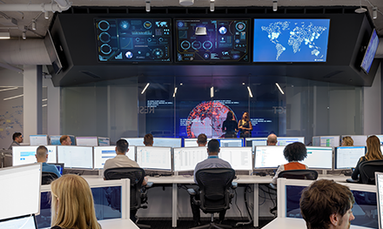
Modern SOC Challenges
Three of the modern security operations center (SOC) challenges are:
The volume of cyber threats is growing while SOC capacity remains the same
Day-to-day work is eating SOC capacity, leaving little no time for strategic initiatives and projects
The time to respond to incoming threats is high.
Imagine having a virtual analyst in your Tier 1 / Tier 2 SOC team that mimics the ideal steps that SecOps would take to investigate and remediate threats.
The virtual assistant could work 24x7, with unlimited capacity.
Such a virtual analyst can take on a significant load of investigations and threat remediation, significantly reducing the time to respond, and freeing up your SOC team for other important strategic.
Notes:
https://techcommunity.microsoft.com/t5/microsoft-defender-for-endpoint/enhance-your-soc-with-microsoft-defender-atp-automatic/ba-p/848946

Slide 37

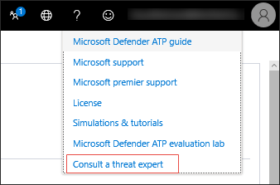
Microsoft Threat Experts
A managed threat hunting service that provides your Security Operation Centers (SOCs) with expert level monitoring and analysis to help them ensure that critical threats in your unique environments don’t get missed.
Customers must apply for Microsoft Threat Experts - Targeted Attack Notifications. Approval gains access to special insights and analysis that help identify the most critical threats
The managed hunting service includes:
Threat monitoring and analysis, reducing dwell time and risk to the business
Hunter-trained artificial intelligence to discover and prioritize both known and unknown attacks
Identifying the most important risks, helping SOCs maximize time and energy
Scope of compromise and as much context as can be quickly delivered to enable fast SOC response.
Notes:
Microsoft Threat Experts | Microsoft Docs

Slide 38

Target Attack Notification
Provides proactive hunting for the most important threats to your network, including human adversary intrusions, hands-on-keyboard attacks, or advanced attacks like cyber-espionage. These notifications shows up as a new alert. The managed hunting service includes:
Threat monitoring and analysis, reducing dwell time and risk to the business
Hunter-trained artificial intelligence to discover and prioritize both known and unknown attacks
Identifying the most important risks, helping SOCs maximize time and energy
Scope of compromise and as much context as can be quickly delivered to enable fast SOC response.
Notes:
Microsoft Threat Experts | Microsoft Docs

Slide 39
Microsoft Defender for Endpoint – Cross Platform

Slide 40
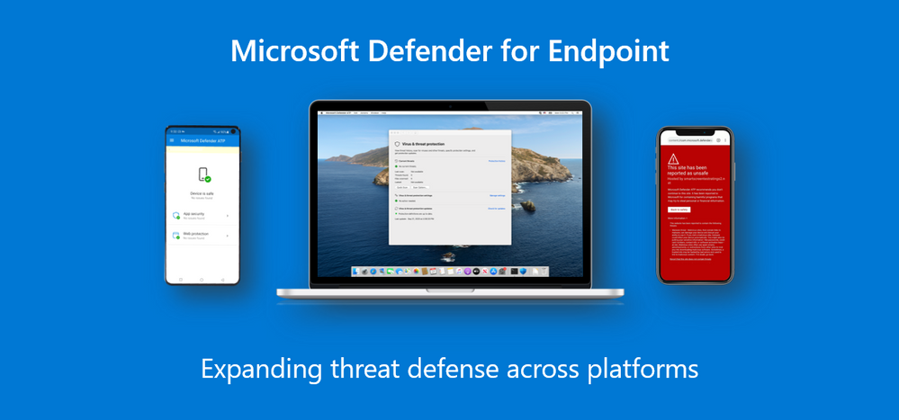
Cross Platform
Microsoft Defender for Endpoint extends endpoint security beyond Windows to Mac, Linux, Android, and iOS.
With Microsoft Defender for Endpoint, now available on all the major platforms, security teams benefit from having a single, unified view of alerts, events, and threat insights, giving them visibility across all endpoints their employees are using to get their jobs done.
Notes:
https://docs.microsoft.com/en-us/microsoft-365/security/defender-endpoint/onboard-configure?view=o365-worldwide

Slide 41
Mobile
The threats on mobile are unique, with phishing being the biggest and fastest growing threat. More than 85% of these attacks take place outside of email through phishing websites, messaging apps, games, and other apps.
Phishing is where we believe we bring the strength of the Microsoft security platform to bear.
The scale of Microsoft Defender gives visibility into the billions of phishing attacks and social engineering techniques our customers face and enables us to detect and prevent these attacks on mobile.
Notes:
https://docs.microsoft.com/en-us/microsoft-365/security/defender-endpoint/onboard-configure?view=o365-worldwide

Slide 42
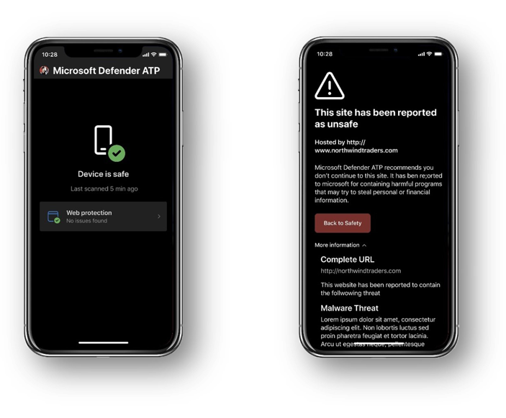
iOS
Microsoft Defender for iOS is our mobile threat defense solution for devices running iOS 11.0 and higher.
Both Supervised and Unsupervised devices are supported.
On iOS, Microsoft Defender offers:
Anti-Phishing
Block network connections
Allow/Block URLs
Notes:
https://techcommunity.microsoft.com/t5/microsoft-defender-for-endpoint/microsoft-defender-for-endpoint-on-ios-is-generally-available/ba-p/1962420

Slide 43
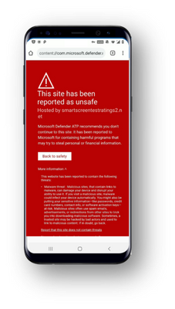
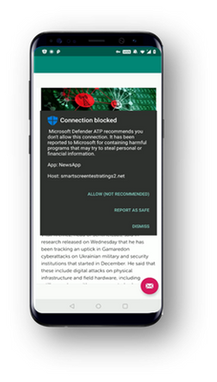
Android
Microsoft Defender for Endpoint on Android is our mobile threat defense solution for devices running Android 6.0 and higher.
Both Android Enterprise (Work Profile) and Device Administrator modes are supported.
On Android, Microsoft Defender offers:
Anti-Phishing
Block network connections
Allow/Block URLs
Malware Scan
Storage and memory peripheral scan
Block risky devices
Notes:
https://techcommunity.microsoft.com/t5/microsoft-defender-for-endpoint/announcing-microsoft-defender-atp-for-android/ba-p/1480787

Slide 44
Onboarding - Mobile
iOS + Android support:
App Store
Endpoint Management
Endpoint Management forces the deployment of the app to the devices
Auto setup of always on VPN deployment option
Doesn’t require user to do any setup during onboarding
Notes:
https://docs.microsoft.com/en-us/microsoft-365/security/defender-endpoint/onboard-configure?view=o365-worldwide

Slide 45
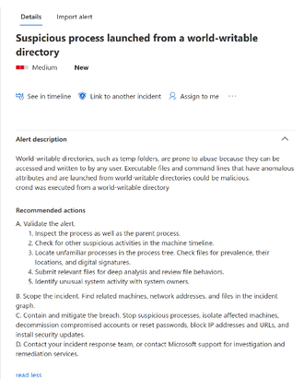
Linux
Microsoft Defender for Endpoint on Linux offers preventative (AV) capabilities for Linux servers.
This includes a full command line experience to configure and manage the agent, initiate scans, and manage threats. Defender for Endpoint is able to capture Linux file server activity, including sign-in, connections, read and copied files, various discovery activities, and Pass-the-Hash (PtH).
We support recent versions of the six most common Linux Server distributions: RHEL 7.2+, CentOS Linux 7.2+, Ubuntu 16 LTS, or higher LTS, SLES 12+, Debian 9+, and Oracle Linux 7.2.
Microsoft Defender for Endpoint on Linux can be deployed and configured using Puppet, Ansible, or using your existing Linux configuration management tool.
Notes:
https://docs.microsoft.com/en-us/microsoft-365/security/defender-endpoint/microsoft-defender-endpoint-linux?view=o365-worldwide
https://techcommunity.microsoft.com/t5/microsoft-defender-for-endpoint/secure-configuration-assessment-for-macos-and-linux-now-in/ba-p/2320517
https://techcommunity.microsoft.com/t5/microsoft-defender-for-endpoint/edr-for-linux-is-now-generally-available/ba-p/2048539

Slide 46
Onboarding - Linux
Multiple channels available
insiders-fast, insiders-slow, or prod.
Each of these channels corresponds to a Linux software repository. The choice of the channel determines the type and frequency of updates that are offered to your device.
Devices in insiders-fast are the first ones to receive updates and new features, followed later by insiders-slow and lastly by prod.
Switching the channel after the initial installation requires the product to be reinstalled.
OS supported deployment tools, bash script, Ansible, Chef and Puppet supported.
Running Defender for Endpoint on Linux side by side with other fanotify-based security solutions is not supported.
Notes:
https://docs.microsoft.com/en-us/microsoft-365/security/defender-endpoint/onboard-configure?view=o365-worldwide

Slide 47
macOS
The three most recent major releases of macOS are supported. Beta versions of macOS are not supported.
macOS devices with M1 processors are not supported.
After you've enabled the service, you may need to configure your network or firewall to allow outbound connections between it and your endpoints.
Spreadsheet of specific DNS records for service locations, geographic locations, and OS.
Notes:
https://docs.microsoft.com/en-us/microsoft-365/security/defender-endpoint/onboard-configure?view=o365-worldwide
https://download.microsoft.com/download/8/a/5/8a51eee5-cd02-431c-9d78-a58b7f77c070/mde-urls.xlsx

Slide 48
Onboarding - macOS
Deployment via Manual, Endpoint Management, JAMF, or other MDM solution available
Configuration profile must be built to allow Microsoft Defender can operate properly. Some examples:
Disk Access - macOS 10.15 (Catalina) contains new security and privacy enhancements. Beginning with this version, by default, applications are not able to access certain locations on disk (such as Documents, Downloads, Desktop, etc.) without explicit consent.
Network Filter - As part of the Endpoint Detection and Response capabilities, Microsoft Defender for Endpoint on macOS inspects socket traffic and reports this information to the Microsoft Defender Security Center portal.
Notes:
https://docs.microsoft.com/en-us/microsoft-365/security/defender-endpoint/mac-install-with-intune?view=o365-worldwide
https://docs.microsoft.com/en-us/microsoft-365/security/defender-endpoint/mac-install-manually?view=o365-worldwide
https://docs.microsoft.com/en-us/microsoft-365/security/defender-endpoint/microsoft-defender-endpoint-linux?view=o365-worldwide
https://techcommunity.microsoft.com/t5/microsoft-defender-for-endpoint/secure-configuration-assessment-for-macos-and-linux-now-in/ba-p/2320517

Slide 49
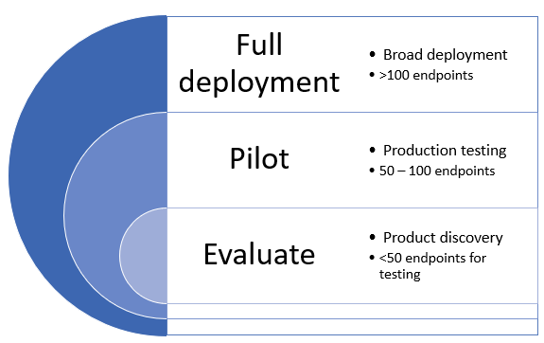
Deployment Rings
A ring-based approach is a method of identifying a set of endpoints to onboard and verifying that certain criteria is met before proceeding to deploy the service to a larger set of devices.
You can define the exit criteria for each ring and ensure that they are satisfied before moving on to the next ring.
Notes:
https://docs.microsoft.com/en-us/microsoft-365/security/defender-endpoint/deployment-rings?view=o365-worldwide

Slide 50
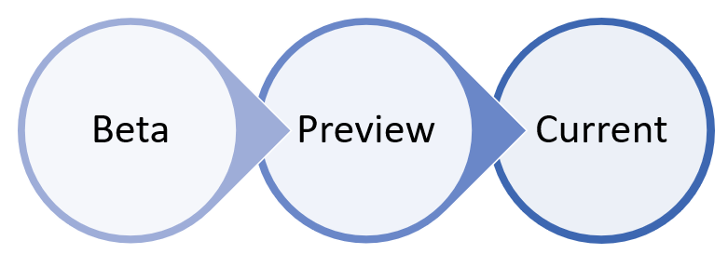
Channels
The choice of the channel determines the type and frequency of updates that are offered to your device. Devices in Beta are the first ones to receive updates and new features, followed later by Preview and lastly by Current.
In order to preview new features and provide early feedback, it is recommended that you configure some devices in your enterprise to use either Beta or Preview. Switching the channel after the initial installation requires the product to be reinstalled
Notes:
https://docs.microsoft.com/en-us/microsoft-365/security/defender-endpoint/deployment-rings?view=o365-worldwide

Slide 51
Smart Screen
Microsoft Defender SmartScreen protects against phishing or malware websites and applications, and the downloading of potentially malicious files.
Provides an early warning system against websites that might engage in phishing attacks or attempt to distribute malware through a socially engineered attack.
Microsoft Defender SmartScreen works with Intune, Group Policy, and mobile device management (MDM) settings to help you manage your organization's computer settings. Based on how you set up Microsoft Defender SmartScreen, you can show employees a warning page and let them continue to the site, or you can block the site entirely.
Notes:
Microsoft Defender SmartScreen overview (Windows 10) - Windows security | Microsoft Docs
Microsoft Defender SmartScreen Frequently Asked Questions
Available Microsoft Defender SmartScreen Group Policy and mobile device management (MDM) settings (Windows 10) - Windows security | Microsoft Docs

Slide 52
Smart Screen - Benefits
Anti-phishing and anti-malware support
Reputation-based URL and app protection
Operating system integration
Improved heuristics and diagnostic data
Management through Group Policy and Microsoft Intune
Blocking URLs associated with potentially unwanted applications
Notes:
Anti-phishing and anti-malware support. Microsoft Defender SmartScreen helps to protect users from sites that are reported to host phishing attacks or attempt to distribute malicious software. It can also help protect against deceptive advertisements, scam sites, and drive-by attacks. Drive-by attacks are web-based attacks that tend to start on a trusted site, targeting security vulnerabilities in commonly used software. Because drive-by attacks can happen even if the user does not click or download anything on the page, the danger often goes unnoticed. For more info about drive-by attacks, see Evolving Microsoft Defender SmartScreen to protect you from drive-by attacks
Reputation-based URL and app protection. Microsoft Defender SmartScreen evaluates a website's URLs to determine if they're known to distribute or host unsafe content. It also provides reputation checks for apps, checking downloaded programs and the digital signature used to sign a file. If a URL, a file, an app, or a certificate has an established reputation, users won't see any warnings. If, however, there's no reputation, the item is marked as a higher risk and presents a warning to the user.
Operating system integration. Microsoft Defender SmartScreen is integrated into the Windows 10 operating system. It checks any files an app (including 3rd-party browsers and email clients) attempts to download and run.
Improved heuristics and diagnostic data. Microsoft Defender SmartScreen is constantly learning and endeavoring to stay up to date, so it can help to protect you against potentially malicious sites and files.
Management through Group Policy and Microsoft Intune. Microsoft Defender SmartScreen supports using both Group Policy and Microsoft Intune settings. For more info about all available settings, see Available Microsoft Defender SmartScreen Group Policy and mobile device management (MDM) settings.
Blocking URLs associated with potentially unwanted applications. In Microsoft Edge (based on Chromium), SmartScreen blocks URLs associated with potentially unwanted applications, or PUAs. For more information on blocking URLs associated with PUAs, see Detect and block potentially unwanted applications.

Slide 53
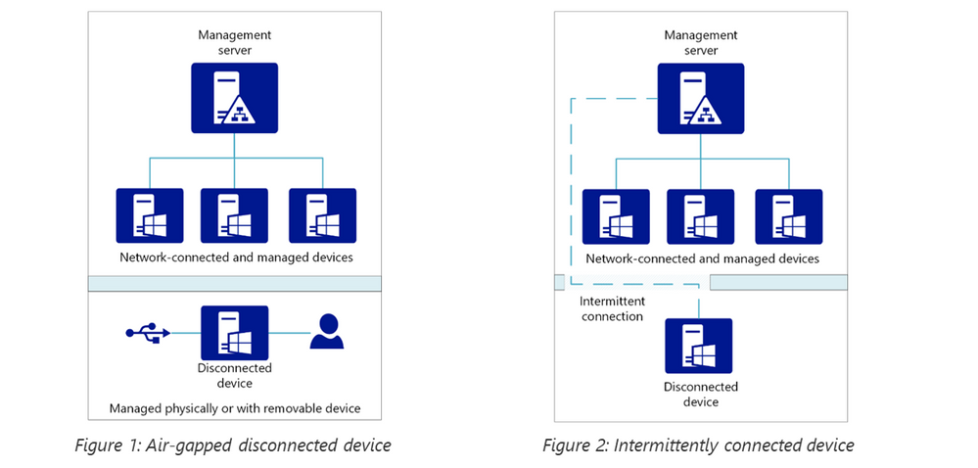
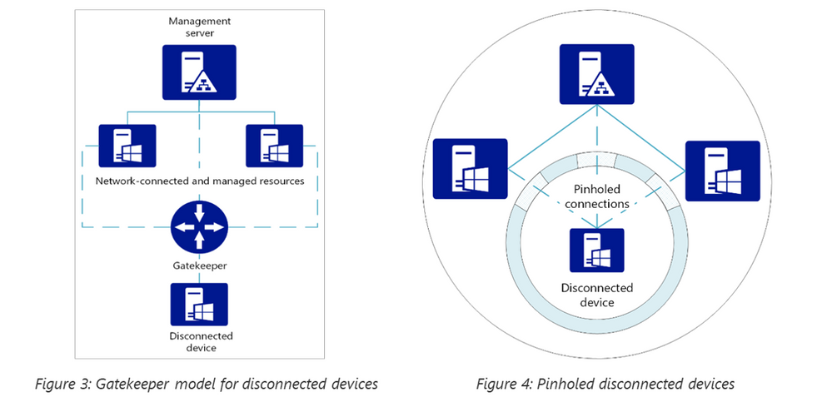
Disconnected Devices - Scenarios
Microsoft Defender, a cloud-based solution = Not all devices can be connected to an external endpoint.
Consider what type of disconnected scenario you have
Notes:
Protecting disconnected devices with Microsoft Defender ATP - Microsoft Tech Community

Slide 54
Disconnected Devices – Update Delivery
Consider how updates are delivered and how configuration is managed:
Inventory. Any auxiliary device that is connected to the disconnected device at any level of relationship (primary, secondary, tertiary) needs to be protected.
Update management (device). Determine where your updates get onto the disconnected device. Is it with a USB thumb drive? A management repository that can only connect to the disconnected device
Update management (relationships). Go the next level up – how do updates get onto that auxiliary device? Are they downloaded onto a PC, and then copied to the USB thumb drive? Are they distributed via Config Manager onto your management repo? What gates are involved and what other devices are connected to the auxiliary updating device?
User permissions. Who uses the disconnected device? What admin privileges do they have? Can they install apps or change settings?
Removable device control. Do users ever need to plug in removable devices? What’s the core purpose of the device?
Notes:
Protecting disconnected devices with Microsoft Defender ATP - Microsoft Tech Community

Slide 55

Licensing
Any of these licenses gives you access to Microsoft 365 Defender features in Microsoft 365 security center without additional cost:
Microsoft 365 E5 or A5
Microsoft 365 E3 with the Microsoft 365 E5 Security add-on
Microsoft 365 A3 with the Microsoft 365 A5 Security add-on
Windows 10 Enterprise E5 or A5
Enterprise Mobility + Security (EMS) E5 or A5
Office 365 E5 or A5
Microsoft Defender for Endpoint
Microsoft Defender for Identity
Microsoft Cloud App Security
Defender for Office 365 (Plan 2)
Notes:
https://docs.microsoft.com/en-us/microsoft-365/security/defender/prerequisites?view=o365-worldwide#licensing-requirements

Slide 56
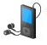
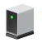

Licensing - Devices
Eligible Licensed Users may use Microsoft Defender for Endpoint on up to five concurrent devices. Microsoft Defender for Endpoint is also available for purchase from a Cloud Solution Provider (CSP).
Microsoft Defender for Endpoint on Android and iOS are included as part of the five qualified devices for eligible licensed users.
Defender for Endpoint on Linux is available through the Defender for Endpoint Server SKU that is available for both commercial and education customers.
Notes:
https://docs.microsoft.com/en-us/microsoft-365/security/defender-endpoint/non-windows?view=o365-worldwide#licensing-requirements

Slide 57


Question…
Which two roles allows you to enable Microsoft 365 Defender?
Notes:
You must be a global administrator or a security administrator in Azure Active Directory to turn on Microsoft 365 Defender.
https://docs.microsoft.com/en-us/microsoft-365/security/defender/prerequisites?view=o365-worldwide#licensing-requirements

Slide 58
Microsoft Defender - Antivirus

Slide 59


Microsoft Defender - Antivirus
Microsoft Defender Antivirus is the next-generation protection component of Microsoft Defender for Endpoint.
This protection brings together machine learning, big-data analysis, in-depth threat resistance research, and the Microsoft cloud infrastructure to protect devices in your enterprise organization.
Behavior-based, heuristic, and real-time antivirus protection, which includes always-on scanning using file and process behavior monitoring and other heuristics (also known as real-time protection). It also includes detecting and blocking apps that are deemed unsafe, but might not be detected as malware.
Cloud-delivered protection, which includes near-instant detection and blocking of new and emerging threats.
Dedicated protection and product updates, which includes updates related to keeping Microsoft Defender Antivirus up to date.
Notes:
Next-generation protection | Microsoft Docs
Why you should use Microsoft Defender Antivirus together with Microsoft Defender for Endpoint | Microsoft Docs

Slide 60

Endpoint + Antivirus – Better Together
Antivirus signal sharing - Microsoft applications and services share signals across your enterprise organization, providing a stronger single platform
Microsoft Defender Antivirus collects underlying system data used by threat analytics and Microsoft Secure Score for Devices.
Performance - Microsoft Defender for Endpoint is designed to work with Microsoft Defender Antivirus, so you get better performance when you use these offerings together.
Malware Details - More details and actions for blocked malware are available with Microsoft Defender Antivirus and Microsoft Defender for Endpoint
Network Protection - Your organization's security team can protect your network by blocking specific URLs and IP addresses
File blocking - Your organization's security team can block specific files
One company to call for technical support.
Notes:
Next-generation protection | Microsoft Docs
Why you should use Microsoft Defender Antivirus together with Microsoft Defender for Endpoint | Microsoft Docs

Slide 61
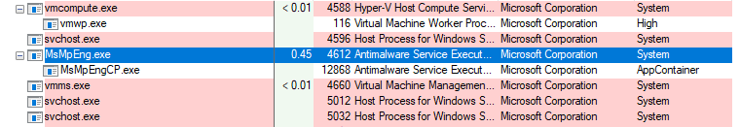
Sandbox Execution
In order for Windows Defender Antivirus to inspect the whole system for malicious content and artifacts, it runs with high privileges. This makes it a candidate for attacks.
Security researchers both inside and outside of Microsoft have previously identified ways that an attacker can take advantage of vulnerabilities in Windows Defender Antivirus’s content parsers that could enable arbitrary code execution.
Running Windows Defender Antivirus in a sandbox (Content Process) ensures that in the unlikely event of a compromise, malicious actions are limited to the isolated environment, protecting the rest of the system from harm.
The content processes, which run with low privileges, also aggressively leverage all available mitigation policies to reduce the attack surface. They enable and prevent runtime changes for modern exploit mitigation techniques such as Data Execution Prevention (DEP), Address space layout randomization (ASLR), and Control Flow Guard (CFG).
Notes:
Windows Defender Antivirus can now run in a sandbox - Microsoft Security

Slide 62

Tamper Protection
Setting available in the Windows Security app provider additional protections against changes to key security features, including limiting changes that are not made directly through the app.
Home users can toggle the setting from the Virus & threat protection settings area in the app. For enterprise environments, the setting can be managed centrally through the Endpoint Management (Intune) portal.
Will prevent disabling the following:
Real-time protection, which is the core antimalware scanning feature of Microsoft Defender ATP next gen protection and should rarely, if ever, be disabled
Cloud-delivered protection, which uses our cloud-based detection and prevention services to block never-before seen malware within seconds
IOAV, which handles the detection of suspicious files from the Internet
Behavior monitoring, which works with real-time protection to analyze and determine if active processes are behaving in a suspicious or malicious way and blocks them
Notes:
Tamper protection in Microsoft Defender ATP - Microsoft Tech Community

Slide 63

Onboarding
Because the Microsoft Defender Antivirus client is installed as a core part of Windows 10, traditional deployment of a client to your endpoints does not apply.
However, in most cases you will still need to enable the protection service on your endpoints with Microsoft Intune, Microsoft Endpoint Configuration Manager, Azure Defender, or Group Policy Objects.
In most cases, Windows 10 will disable Microsoft Defender Antivirus if it finds another antivirus product that is running and up-to-date.
You must disable or uninstall third-party antivirus products before Microsoft Defender Antivirus will function. If you re-enable or install third-party antivirus products, then Windows 10 automatically disables Microsoft Defender Antivirus.
Notes:
https://docs.microsoft.com/en-us/microsoft-365/security/defender-endpoint/deploy-manage-report-microsoft-defender-antivirus?view=o365-worldwide

Slide 64
DEMO: How to whiteboard designs

Slide 65
Breakout Activity: Microsoft Defender Onboarding
As a result of participating in this activity, you will better be able to Plan and perform Microsoft Defender onboarding
OUTCOMES
ACTIVITY
30 minutes
Learning Adviser
Table Group Channel
As a team review WWI requirements provided in student guide
Open the whiteboard and as a team answer the provided challenge questions.
The questions are pre-loaded into the whiteboard.
Welcome | Keynote | Demo Walkthrough | Break | Microsoft Defender for EndPoint + Antivirus | Activity: Microsoft Defender Onboarding | Break | Lab: Microsoft Defender Onboarding | Break | Microsoft Defender Portal | Activity: Microsoft Defender Portal | Lab: Microsoft Defender Portal | Closing

Slide 66
Microsoft Defender – Case Studies

Slide 67

Case Studies - Thycotic
Thycotic is a privileged access management (PAM) vendor providing customers with a platform to secure access and permissions across enterprise environments. Its security teams were stretched thin trying to manage multiple security tools for robust, relevant detection and response.
Thycotic replaced a legacy multi-vendor solution with Red Canary’s Microsoft Defender for Endpoint (formerly Microsoft Defender Advanced Threat Protection) integration and Managed Detection and Response solution. The result: alert fatigue was reduced by 90%.
Notes:
Microsoft Customer Stories Search
Microsoft Customer Story-Cerner drives customer confidence, improves security and compliance posture with Microsoft 365
Microsoft Customer Story-Thycotic reduces alert fatigue with Red Canary and Microsoft Defender for Endpoint

Slide 68

Case Studies - Cerner
Cerner also opted for Microsoft 365 to take advantage of Microsoft Defender Advanced Threat Protection. Embedded in Windows 10, this solution helps to protect endpoints from cyberthreats and automates remediation of security incidents.
“Microsoft security services make us think more holistically about what products to bring in that reduce the number of panes of glass your security folks need to look at,” says Kleoppel.
“It doesn’t matter if we have more than one operating system in our environment, it’s all covered in one integrated suite of security services. With Microsoft 365, we have a consistent, global set of controls over all aspects of our data management and security environment.”
Notes:
Microsoft Customer Stories Search
Microsoft Customer Story-Cerner drives customer confidence, improves security and compliance posture with Microsoft 365
Microsoft Customer Story-Thycotic reduces alert fatigue with Red Canary and Microsoft Defender for Endpoint

Slide 69

Customer Demo Environment
Get Customer’s trying out Microsoft Defender today!
VDIU Testing, Block At First Sight, Potentially Unwanted Applications
Attack Surface Reduction, Controlled Folder Access, Network Protection, Exploit Protection
URL Reputation, App Reputation
Home - Microsoft Defender Testground
Notes:
Next-generation protection | Microsoft Docs
Home - Microsoft Defender Testground

Slide 70
Thank You slide
Long Break (60 mins)

Slide 71
Welcome Back!
8:00-8:05 | Welcome
8:05-8:30 | Microsoft 365 Defender / Microsoft Defender for Endpoint
8:30-8:45 | Demo Walkthrough
8:45-9:00 | Break
9:00-10:00 | Microsoft Defender for EndPoint, Microsoft Antivirus
10:00-10:30 | Activity: Microsoft Defender | Table Group Call
10:30-10:45 | Break
10:45-12:00 | Build Hands-on: Microsoft Defender Onboarding | Table Group Call
12:00-1:00 | Long Break | Main Call
1:00-1:30 | Microsoft Defender Portal
1:30-2:00 | Activity: Microsoft Defender | Table Group Call
2:00-4:00 | Build Hands-on: Microsoft Defender Portal
4:00-4:15 | Closing | Main Call
Presentation/
Whole Group
Lab
Activity/ Discussion/ Group Work
Announcements

Slide 72
Microsoft Defender Portal

Slide 73
Microsoft Defender – Security Center

Slide 74
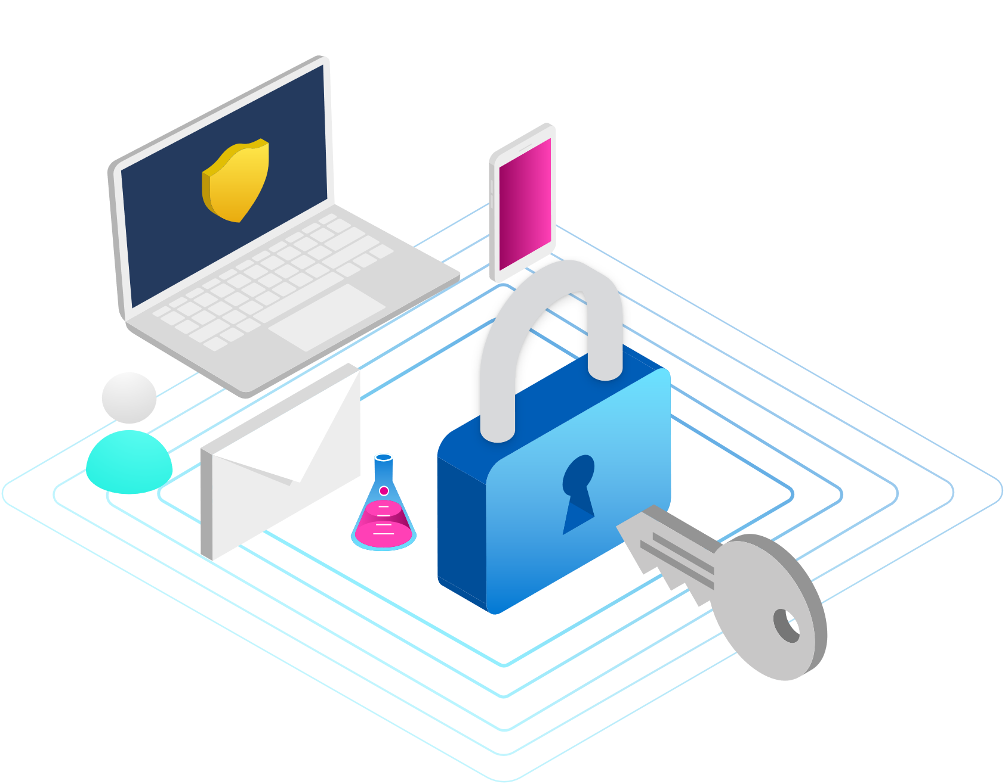
Microsoft Defender for Endpoint – Security Center
The cloud-based portal for managing your Microsoft Defender for Endpoint, use it too:
View, sort, and triage alerts from your endpoints
Search for more information on observed indicators such as files and IP Addresses
Change Microsoft Defender for Endpoint settings, including time zone and review licensing information
Use the navigation pane to move between Dashboards, Incidents, Devices list, Alerts queue, Automated investigations, Advanced hunting, Reports, Partners & APIs, Threat & Vulnerability Management, Evaluation and tutorials, Service health, Configuration management, and Settings.
Access the active automated investigations, active alerts, automated investigations statistics, devices at risk, users at risk, devices with sensor issues, service health, detection sources, and daily devices reporting dashboards.

Slide 75
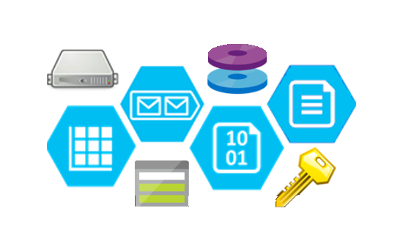
Microsoft Defender for Endpoint – Data Storage
Microsoft Defender for Endpoint will collect and store information from your configured devices in a customer dedicated and segregated tenant specific to the service for administration, tracking, and reporting purposes.
Information collected includes file data (such as file names, sizes, and hashes), process data (running processes, hashes), registry data, network connection data (host IPs and ports), and device details (such as device identifiers, names, and the operating system version).
Microsoft stores this data securely in Microsoft Azure (Log Analytics) and maintains it in accordance with Microsoft privacy practices and Microsoft Trust Center policies.
This data enables Defender for Endpoint to:
Proactively identify indicators of attack (IOAs) in your organization
Generate alerts if a possible attack was detected
Provide your security operations with a view into devices, files, and URLs related to threat signals from your network, enabling you to investigate and explore the presence of security threats on the network.
Notes:
https://docs.microsoft.com/en-us/microsoft-365/security/defender-endpoint/data-storage-privacy?view=o365-worldwide

Slide 76
Microsoft Defender for Endpoint – Data Protection
Region where data is stored is determined when the instance is configured.
Defender for Endpoint operates in the Microsoft Azure datacenters in the European Union, the United Kingdom, or in the United States. Customer data collected by the service may be stored in: (a) the geo-location of the tenant as identified during provisioning or, (b) if Defender for Endpoint uses another Microsoft online service to process such data, the geolocation as defined by the data storage rules of that other online service.
Customer data in pseudonymized form may also be stored in the central storage and processing systems in the United States.
Once configured, you cannot change the location where your data is stored. This provides a convenient way to minimize compliance risk by actively selecting the geographic locations where your data will reside.
Notes:
https://docs.microsoft.com/en-us/microsoft-365/security/defender-endpoint/data-storage-privacy?view=o365-worldwide

Slide 77
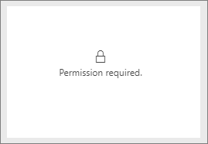
Microsoft Defender for Endpoint – Permissions
Full access
Users with full access can log in, view all system information and resolve alerts, submit files for deep analysis, and download the onboarding package.
Assigning full access rights requires adding the users to the "Security Administrator" or "Global Administrator" AAD built-in roles.
Read-only access
Users with read-only access can log in, view all alerts, and related information. They will not be able to change alert states, submit files for deep analysis or perform any state changing operations.
Assigning read-only access rights requires adding the users to the "Security Reader" Azure AD built-in role.

Slide 78
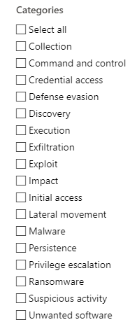
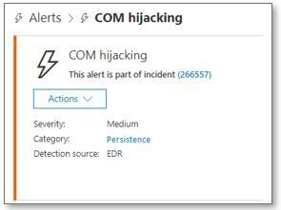
Alerts
Defender for Endpoint notifies you of possible malicious events, attributes, and contextual information through alerts.
Alerts categories are aligned with MITRE ATT&CK Framework Tactics and Techniques. Category alignment will help users better understand threat activities, correlate with additional data sources, and benefit from community enrichments.
A summary of new alerts is displayed in the Security operations dashboard, and you can access all alerts in the Alerts queue.
If an alert is not yet assigned, you can select Assign to me to assign the alert to yourself.
Notes:
https://techcommunity.microsoft.com/t5/microsoft-defender-for-endpoint/mitre-att-amp-ck-technique-info-in-microsoft-defender-atp-alerts/ba-p/856835

Slide 79
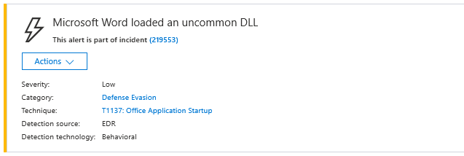
Alerts – Suppression Rules
Suppression rules allow for specific alerts that are known to be innocuous such as known tools or processes in your organization to be suppressed.
When a suppression rule is created, it will take effect from the point when the rule is created.
You can choose not to set a classification, or specify whether an alert is a true alert or a false alert. It's important to provide the classification of true positive/false positive. This classification is used to monitor alert quality, and make alerts more accurate.
Notes:
https://docs.microsoft.com/en-us/microsoft-365/security/defender-endpoint/manage-suppression-rules?view=o365-worldwide

Slide 80

Incidents Queue
Managing incidents is an important part of every cybersecurity operation.
You can manage incidents by selecting an incident from the Incidents queue or the Incidents management pane.
The Incidents queue shows a collection of incidents that were flagged from devices in your network. It helps you sort through incidents to prioritize and create an informed cybersecurity response decision.
By default, the queue displays incidents seen in the last 30 days, with the most recent incident showing at the top of the list, helping you see the most recent incidents first.
To understand the incident's scope at a glance, incident names are automatically generated based on alert attributes such as the number of endpoints affected, users affected, detection sources or categories.
You can assign incidents to yourself, change the status and classification, rename, or comment on them to keep track of their progress.
Notes:
https://docs.microsoft.com/en-us/microsoft-365/security/defender-endpoint/manage-incidents?view=o365-worldwide

Slide 81

Alerts vs Incidents
You can investigate the alerts and see how they were linked together in an incident.
Alerts are grouped into incidents based on the following reasons:
Automated investigation - The automated investigation triggered the linked alert while investigating the original alert
File characteristics - The files associated with the alert have similar characteristics
Manual association - A user manually linked the alerts
Proximate time - The alerts were triggered on the same device within a certain timeframe
Same file - The files associated with the alert are exactly the same
Same URL - The URL that triggered the alert is exactly the same
Notes:
https://docs.microsoft.com/en-us/microsoft-365/security/defender-endpoint/manage-incidents?view=o365-worldwide

Slide 82
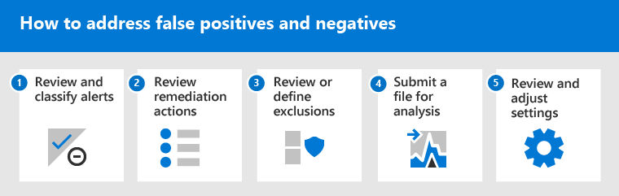
False Positives/Negatives
A false positive is an entity, such as a file or a process, that was detected and identified as malicious, even though the entity isn't actually a threat.
A false negative is an entity that was not detected as a threat, even though it actually is malicious.
Notes:
https://docs.microsoft.com/en-us/microsoft-365/security/defender-endpoint/defender-endpoint-false-positives-negatives?view=o365-worldwide

Slide 83


Remediation Actions
Several types of remediation actions occur automatically through automated investigation and Microsoft Defender Antivirus:
Quarantine a file
Remove a registry key
Kill a process
Stop a service
Disable a driver
Remove a scheduled task

Slide 84

Quarantine Files
You can roll back and remove a file from quarantine if you’ve determined that it’s clean after an investigation.
Notes:
https://docs.microsoft.com/en-us/microsoft-365/security/defender-endpoint/defender-endpoint-false-positives-negatives?view=o365-worldwide

Slide 85
Exclusions
An exclusion is an entity, such as a file or URL, that you specify as an exception to remediation actions.
The excluded entity can still get detected, but no remediation actions are taken on that entity.
That is, the detected file or process won’t be stopped, sent to quarantine, removed, or otherwise changed by Microsoft Defender for Endpoint.
Microsoft Defender Antivirus exclusions apply only to antivirus protection, not across other Microsoft Defender for Endpoint capabilities.
To exclude files broadly, use exclusions for Microsoft Defender Antivirus and custom indicators for Microsoft Defender for Endpoint.
Make sure that you define exclusions sparingly, and that you only include the files, folders, processes, and process-opened files that are resulting in false positives.
Notes:
https://docs.microsoft.com/en-us/microsoft-365/security/defender-endpoint/defender-endpoint-false-positives-negatives?view=o365-worldwide

Slide 86
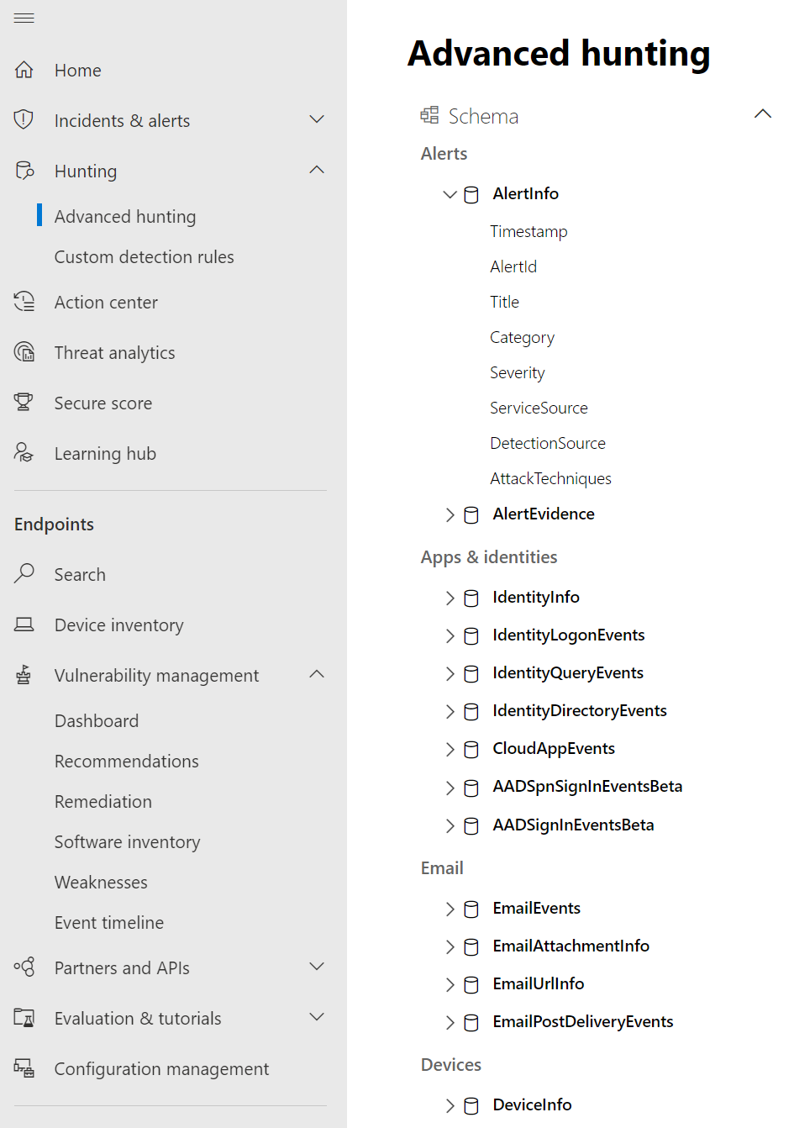
Hunting
Advanced hunting is a query-based threat-hunting tool that lets you explore up to 30 days of raw data.
You can proactively inspect events in your network to locate threat indicators and entities.
The flexible access to data enables unconstrained hunting for both known and potential threats.
Time information in advanced hunting is in the UTC time zone.

Slide 87
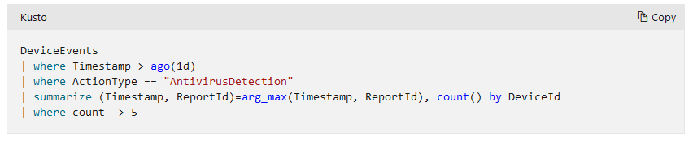
Custom Detection Rules
Custom detection rules are rules you can design and tweak using advanced hunting queries. These rules let you proactively monitor various events and system states, including suspected breach activity and misconfigured endpoints.
You can set them to run at regular intervals, generating alerts and taking response actions whenever there are matches.
To create a custom detection rule, the query must return the following columns:
Timestamp—used to set the timestamp for generated alerts
ReportId—enables lookups for the original records
A column that identifies specific devices, users, or mailboxes

Slide 88
Question…
What is the alert limit for custom detection rules?
Notes:
To prevent the service from returning too many alerts, each rule is limited to generating only 100 alerts whenever it runs.
Before creating a rule, tweak your query to avoid alerting for normal, day-to-day activity.
https://docs.microsoft.com/en-us/microsoft-365/security/defender/custom-detection-rules?view=o365-worldwide
Custom detections should be regularly reviewed for efficiency and effectiveness. To make sure you are creating detections that trigger true alerts, take time to review your existing custom detections by following the steps in Manage existing custom detection rules. You maintain control over the broadness or specificity of your custom detections so any false alerts generated by custom detections might indicate a need to modify certain parameters of the rules.

Slide 89
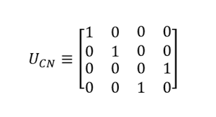
Hunting - Data
Advanced hunting data can be categorized into two distinct types:
Event or activity data—populates tables about alerts, security events, system events, and routine assessments. Advanced hunting receives this data almost immediately after the sensors that collect them successfully transmit them to the corresponding cloud services. For example, you can query event data from healthy sensors on workstations or domain controllers almost immediately after they are available on Microsoft Defender for Endpoint and Microsoft Defender for Identity.
Entity data—populates tables with information about users and devices. This data comes from both relatively static data sources and dynamic sources, such as Active Directory entries and event logs. To provide fresh data, tables are updated with any new information every 15 minutes, adding rows that might not be fully populated. Every 24 hours, data is consolidated to insert a record that contains the latest, most comprehensive data set about each entity.

Slide 90
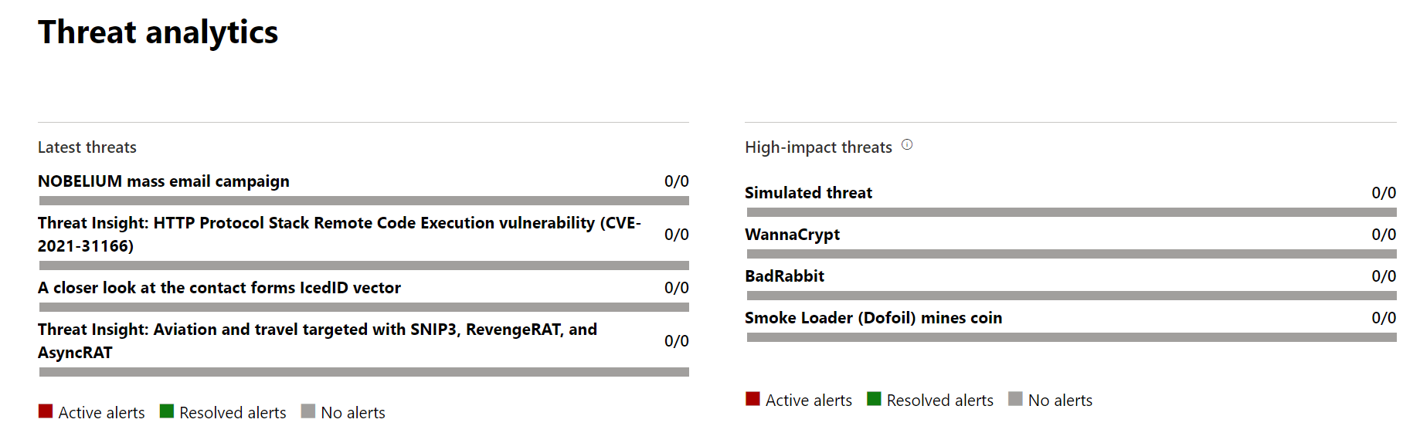
Threat Analytics
Threat analytics is our in-product threat intelligence solution from expert Microsoft security researchers, designed to assist security teams to be as efficient as possible while facing emerging threats, including:
Active threat actors and their campaigns
Popular and new attack techniques
Critical vulnerabilities
Common attack surfaces
Prevalent malware

Slide 91
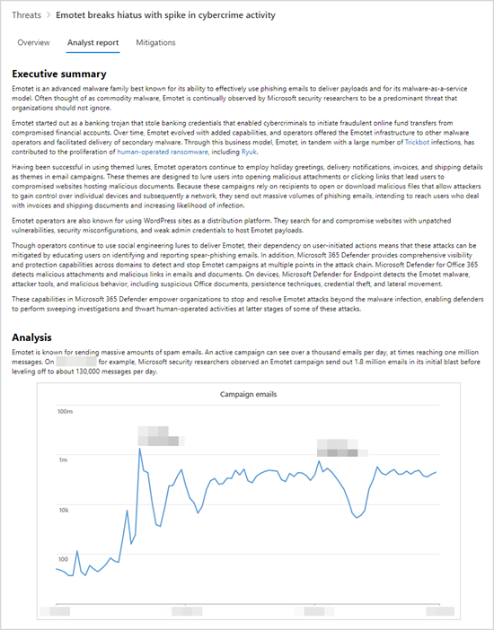
Threat Analytics – Analyst Report
Each threat analytics report includes dynamic sections and a comprehensive written section called the analyst report.
Threat analytics dynamically tracks the status of security updates and secure configurations.
This information is available as charts and tables in the Mitigations tab.
The analyst report also provides the detections from Microsoft Defender for Endpoint antivirus and endpoint detection and response (EDR) capabilities.
Notes:
https://docs.microsoft.com/en-us/microsoft-365/security/defender-endpoint/threat-analytics-analyst-reports?view=o365-worldwide

Slide 92
Vulnerability Management
View your Microsoft Secure Score for Devices, exposure score, exposed devices, vulnerable software, and take action on top security recommendations.
Effectively identifying, assessing, and remediating endpoint weaknesses is pivotal in running a healthy security program and reducing organizational risk. Threat and vulnerability management serves as an infrastructure for reducing organizational exposure, hardening endpoint surface area, and increasing organizational resilience.
Discover vulnerabilities and misconfigurations in real time with sensors, and without the need of agents or periodic scans. It prioritizes vulnerabilities based on the threat landscape, detections in your organization, sensitive information on vulnerable devices, and business context.
Notes:
https://docs.microsoft.com/en-us/microsoft-365/security/defender-endpoint/next-gen-threat-and-vuln-mgt?view=o365-worldwide

Slide 93
Recommendations
See the list of security recommendations and related threat information.
When you select an item from the list, a flyout panel opens with vulnerability details, a link to open the software page, and remediation and exception options.
You can also open a ticket in Intune if your devices are joined through Azure Active Directory and you've enabled your Intune connections in Defender for Endpoint.

Slide 94
Remediation
The threat and vulnerability management capability in Microsoft Defender for Endpoint bridges the gap between Security and IT administrators through the remediation request workflow.
Security admins like you can request for the IT Administrator to remediate a vulnerability from the Security recommendation pages to Intune.
Response actions are only available if the device is enrolled in Microsoft Defender for Endpoint.
Devices that are enrolled in Microsoft Defender for Endpoint may display different numbers of response actions, based on the device's OS and version number.

Slide 95
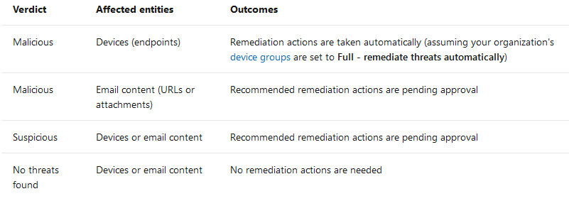
Automated Investigation
When an automated investigation completes, a verdict is reached for every piece of evidence involved.
Depending on the verdict, remediation actions are identified.
In some cases, remediation actions are taken automatically; in other cases, remediation actions await approval. It all depends on how automated investigation and response is configured.

Slide 96
Manual Investigation
In addition to remediation actions that follow automated investigations, your security operations team can take certain remediation actions manually.
These include the following:
Manual device action, such as device isolation or file quarantine
Manual email action, such as soft-deleting email messages
Advanced hunting action on devices or email
Explorer action on email content, such as moving email to junk, soft-deleting email, or hard-deleting email
Manual live response action, such as deleting a file, stopping a process, and removing a scheduled task
Live response action with Microsoft Defender for Endpoint APIs, such as isolating a device, running an antivirus scan, and getting information about a file

Slide 97
Question…
What is the default time zone in Microsoft 365 Defender?
Notes:
By default, Microsoft 365 Defender displays time information in the UTC time zone. You can change this setting to use your local time zone

Slide 98

Software
The software inventory in threat and vulnerability management is a list of known software in your organization with official Common Platform Enumerations (CPE).
Software products without an official CPE don’t have vulnerabilities published. It also includes details such as the name of the vendor, number of weaknesses, threats, and number of exposed devices.
Since it's real time, in a matter of minutes, you'll see vulnerability information as they get discovered.
The engine automatically grabs information from multiple security feeds. In fact, you'll see if a particular software is connected to a live threat campaign. It also provides a link to a Threat Analytics report soon as it's available.
Notes:
https://docs.microsoft.com/en-us/microsoft-365/security/defender-endpoint/tvm-software-inventory?view=o365-worldwide

Slide 99
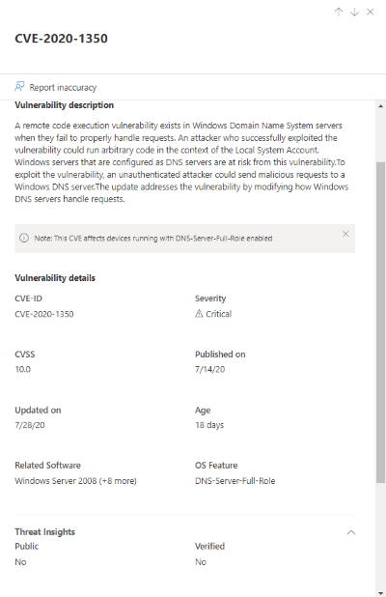
Weaknesses
The Weaknesses page lists the software vulnerabilities your devices are exposed to by listing the Common Vulnerabilities and Exposures (CVE) ID.
You can also view the severity, Common Vulnerability Scoring System (CVSS) rating, prevalence in your organization, corresponding breach, threat insights, and more.
If there is no official CVE-ID assigned to a vulnerability, the vulnerability name is assigned by threat and vulnerability management.
If you select a CVE, a flyout panel will open with more information such as the vulnerability description, details, threat insights, and exposed devices.

Slide 100
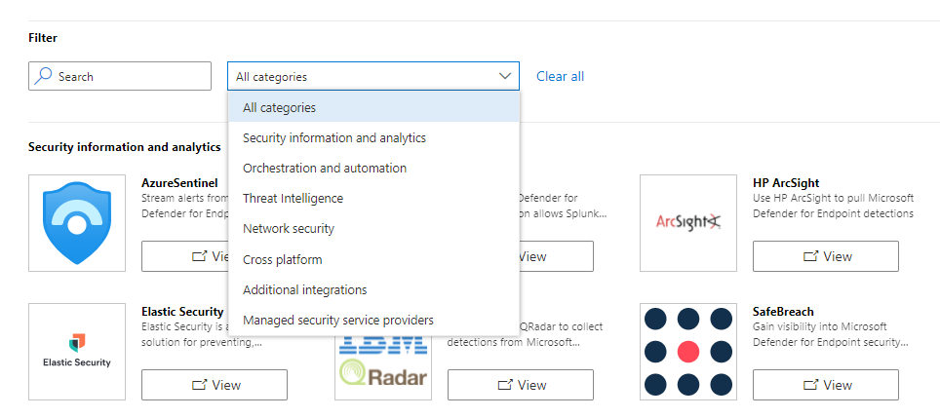
Partner applications
View supported partner connections.
Enhance the detection, investigation, and threat intelligence capabilities of the platform with these supported partner connections.

Slide 101
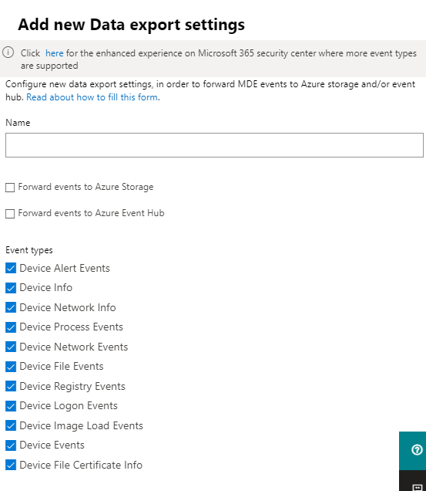
Data Export
Export Microsoft Defender data to Azure Storage or Azure Event Hubs

Slide 102
Evaluation Lab
The Microsoft Defender for Endpoint evaluation lab is designed to eliminate the complexities of device and environment configuration so that you can focus on evaluating the capabilities of the platform, running simulations, and seeing the prevention, detection, and remediation features in action.
With the simplified set-up experience, you can focus on running your own test scenarios and the pre-made simulations to see how Defender for Endpoint performs.
You'll have full access to the powerful capabilities of the platform such as automated investigations, advanced hunting, and threat analytics, allowing you to test the comprehensive protection stack that Defender for Endpoint offers.
You can add Windows 10 or Windows Server 2019 devices that come pre-configured to have the latest OS versions and the right security components in place as well as Office 2019 Standard installed.
You can also install threat simulators. Defender for Endpoint has partnered with industry leading threat simulation platforms to help you test out the Defender for Endpoint capabilities without having to leave the portal.
Notes:
Microsoft Defender for Endpoint evaluation lab | Microsoft Docs

Slide 103
Attack Surface Reduction (Rules)
Your organization's attack surface includes all the places where an attacker could compromise your organization's devices or networks.
Reducing your attack surface means protecting your organization's devices and network, which leaves attackers with fewer ways to perform attacks.
Attack surface reduction rules target certain software behaviors, such as:
Launching executable files and scripts that attempt to download or run files;
Running obfuscated or otherwise suspicious scripts; and
Performing behaviors that apps don't usually initiate during normal day-to-day work.
15 available attack surface reduction rules.

Slide 104
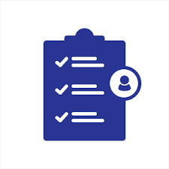
Attack Surface Reduction (Mode)
Audit Mode
Use audit mode to evaluate how attack surface reduction rules would affect your organization if they were enabled. Run all rules in audit mode first so you can understand how they affect your line-of-business applications.
Warn Mode
Prior to warn mode capabilities, attack surface reduction rules that are enabled could be set to either audit mode or block mode. With the new warn mode, whenever content is blocked by an attack surface reduction rule, users see a dialog box that indicates the content is blocked. The dialog box also offers the user an option to unblock the content. The user can then retry their action, and the operation completes.
When a user unblocks content, the content remains unblocked for 24 hours, and then blocking resumes.

Slide 105

Submissions
Microsoft security researchers analyze suspicious files to determine if they are threats, unwanted applications, or normal files.
Submit files you think are malware or files that you believe have been incorrectly classified as malware, or vice versa.
Submission Types (Email, URL, File)
Email (.msg, .eml)
Reason (Should have been, should not have been blocked)
Category (Phish, Malware, Spam)

Slide 106

Policies and Rules – Alert Policy
Use alert policies to track user and admin activities, malware threats, or data loss incidents in your organization. After choosing the activity you want to be alerted on, refine the policy by adding conditions, deciding when to trigger the alert, and who should receive notifications.
Notes:
https://docs.microsoft.com/en-us/microsoft-365/compliance/alert-policies?view=o365-worldwide

Slide 107

Policies and Rules - Threat Policies
Polices –
Anti-phishing - Protect users from phishing attacks, and configure safety tips on suspicious messages.
Anti-spam - Protect your organization's email from spam, including what actions to take if spam is detected
Anti-malware - Protect your organization's email from malware
Safe attachments - Protect your organization from malicious content in email attachments and files in SharePoint, OneDrive, and Teams
Safe links - Protect your users from opening and sharing malicious links in email messages and Office apps
Rules –
Tenant allow/block list
DomainKeys Identified Mail (DKIM) - Add DomainKeys Identified Mail (DKIM) signatures to your domains so recipients know that email messages actually came from your users

Slide 108


Simulations
Run the provide scenarios using the integrated threat simulators or experience how Microsoft Defender for Endpoint detects and facilitates efficient investigation and response using the tutorials.

Slide 109
Live Response
In the modern workplace, employees often work beyond the corporate network boundary, at their homes or while traveling, where the risk for compromise is potentially higher.
If, for example, an executive connects her laptop to a hotel wi-fi and is compromised, SecOps may be forced to wait until the executive is back in the office, leaving her high-value laptop exposed.
Live response gives SecOps instantaneous access to a compromised machine regardless of location using a remote shell and gather any required forensic information.
This powerful feature allows you to:
Gather snapshot of connections, drivers, scheduled tasks, and services, as well as search for specific files or request file analysis to reach a verdict (clean, malicious, or suspicious)
Download malware files for reverse-engineering
Create a tenant-level library of forensic tools like PowerShell scripts and third-party binaries that allow SecOps to gather forensic information like MFT table, firewall logs, event logs, process memory dumps, and others
Run remediation activities such as quarantine file, stop process, remove registry, remove scheduled task, others
Notes:
Incident response at your fingertips with Microsoft Defender ATP live response - Microsoft Tech Community

Slide 110
Live Response – Supported OS
Devices must be running one of the following versions of Windows
Windows 10
Version 1909 or later
Version 1903 with KB4515384
Version 1809 (RS 5) with KB4537818
Version 1803 (RS 4) with KB4537795
Version 1709 (RS 3) with KB4537816
Windows Server 2019 - Only applicable for Public preview
Version 1903 or (with KB4515384) later
Version 1809 (with KB4537818)
Notes:
https://docs.microsoft.com/en-us/microsoft-365/security/defender-endpoint/live-response?view=o365-worldwide#before-you-begin

Slide 111

Roles and Permissions
There are two ways to manage access to Microsoft 365 Defender
Global Azure Active Directory (AD) roles
Custom role access
Accounts assigned the following Global Azure Active Directory (AD) roles can access Microsoft 365 Defender functionality and data:
Global administrator
Security administrator
Security Operator
Global Reader
Security Reader

Slide 112
Custom Roles
Admins are users added to the admin role, and can view any data and complete any task in the Microsoft 365 security center. You should have few admins, and grant users only the permissions needed to perform their duties when you assign access.
Areas of management:
Azure AD
Endpoint Management - Roles, Device Groups
Email and Collaboration Roles

Slide 113

Managed Security Service Provider (MSSP)
Microsoft Defender for Endpoint in Microsoft 365 Defender supports granting access to managed security service providers (MSSPs) in the same that way access is granted in the Microsoft Defender security center.
To implement a multi-tenant delegated access solution, take the following steps:
Enable role-based access control in Defender for Endpoint and connect with Active Directory (AD) groups.
Configure Governance Access Packages for access request and provisioning.
Manage access requests and audits in Microsoft Myaccess.
Notes:
https://docs.microsoft.com/en-us/microsoft-365/security/defender-endpoint/grant-mssp-access?view=o365-worldwide

Slide 114

Endpoint Management Roles
By default, Microsoft Defender uses Azure AD global admin
Roles must be enabled, once enabled, Roles can be created and assigned permissions.
Device Groups require roles to be enabled.

Slide 115
Device Groups
Security operation teams are typically assigned a set of devices. These devices are grouped together based on a set of attributes such as their domains, computer names, or designated tags.
Use them to:
Limit access to related alerts and data to specific Azure AD user groups with assigned RBAC roles
Configure different auto-remediation settings for different sets of devices
Assign specific remediation levels to apply during automated investigations
In an investigation, filter the Devices list to specific device groups by using the Group filter.
Notes:
https://docs.microsoft.com/en-us/microsoft-365/security/defender-endpoint/machine-groups?view=o365-worldwide

Slide 116
Device Tagging
This is a functionality that was introduced to allow you to apply a granular level of control over how you manage your devices.
RBAC - The primary use for tagging is to allow you to create machine groups that can then be used for applying RBAC permissions
Filtering - One of the great benefits of tagging is using them in machine views to present different views of machine lists.
Ways to Tag:
Registry tagging - This is via direct editing of the registry. Only one tag can be specified in the registry.
By setting the tag value in the DeviceTagging key (HKLM:\SOFTWARE\Policies\Microsoft\Windows Advanced Threat Protection\DeviceTagging
Intune - When using Intune, it is possible to utilize a custom policy to set the machine tag value in the registry via the WindowsAdvancedThreatProtection
Manual tagging - One of the easiest ways to tag a device is to simply add a tag value through the machine page in the portal.
Tagging using the API – Use the REST APIs to tag 100/1000s of machines

Slide 117

Device Value
With the high value asset prioritizations, organizations can define a machine’s value.
In threat and vulnerability management, the machine value is used to incorporate the risk appetite of an individual asset into the exposure score calculation. Meaning that machines marked as “high value” will receive more weight in the exposure score calculation.

Slide 118

SIEM Integration
Enhance the detection, investigation, and threat intelligence capabilities of the platform with partner connections.

Slide 119
Azure Sentinel Connector
Easily copy your existing Microsoft Defender for Endpoint advanced hunting queries into Azure Sentinel.
Use the raw event logs to provide further insights for your alerts, hunting, and investigation, and correlate these events with events from other data sources in Azure Sentinel.
Store the logs with increased retention, beyond Microsoft Defender for Endpoint or Microsoft 365 Defender’s default retention of 30 days. You can do so by configuring the retention of your workspace or by configuring per-table retention in Log Analytics.
Notes:
https://docs.microsoft.com/en-us/azure/sentinel/microsoft-365-defender-sentinel-integration

Slide 120
Endpoint Detection and Response (EDR)
Once the malware is already infiltrated to the system without being detected by Antivirus, Endpoint Detection and Response (EDR) feature can detect the malware based on its activities, lateral movement and its behavior.

Slide 121

Azure Information Protection (AIP)
Defender for Endpoint applies the following methods to discover, classify, and protect data:
Data discovery - Identify sensitive data on Windows devices at risk
Data classification - Automatically classify data based on common Microsoft Information Protection (MIP) policies managed in Office 365 Security & Compliance Center. Auto-classification allows you to protect sensitive data even if the end user hasn’t manually classified it.
Turn on the Azure Information Protection integration so that when a file that contains sensitive information is discovered by Defender for Endpoint though labels or information types, it is automatically forwarded to Azure Information Protection from the device.
Notes:
https://docs.microsoft.com/en-us/microsoft-365/security/defender-endpoint/troubleshoot-collect-support-log?view=o365-worldwide

Slide 122

Indicators
Indicator of compromise (IoCs) matching is an essential feature in any endpoint protection solution. Gives SecOps the ability to set a list of indicators for detection and for blocking (prevention and response).
Indicators define the detection, prevention, and exclusion of entities.
You can define the action to be taken as well as the duration for when to apply the action as well as the scope of the device group to apply it to.
There is a limit of 15,000 indicators per tenant. Indicators can be file hashes, IP Addresses, URLs/Domains and Certificates.
File and certificate indicators do not block exclusions defined for Microsoft Defender Antivirus.
Indicators are not supported in Microsoft Defender Antivirus when it is in passive mode.

Slide 123

Tamper Protection (MAPS)
During some kinds of cyber attacks, bad actors try to disable security features, such as anti-virus protection, on your machines.
Bad actors like to disable your security features to get easier access to your data, to install malware, or to otherwise exploit your data, identity, and devices.
Tamper protection helps prevent the following:
Disabling virus and threat protection
Disabling real-time protection
Turning off behavior monitoring
Disabling antivirus (such as IOfficeAntivirus (IOAV))
Disabling cloud-delivered protection
Removing security intelligence updates

Slide 124
Preview Features
The Defender for Endpoint service is constantly being updated to include new feature enhancements and capabilities.
Learn about new features in the Defender for Endpoint preview release and be among the first to try upcoming features by turning on the preview experience.
Turn on the preview experience setting to be among the first to try upcoming features.
https://docs.microsoft.com/en-us/microsoft-365/security/defender-endpoint/preview?view=o365-worldwide#preview-features
Notes:
https://docs.microsoft.com/en-us/microsoft-365/security/defender-endpoint/preview?view=o365-worldwide#preview-features

Slide 125

Microsoft Threat Experts
Microsoft Threat Experts is a managed threat hunting service that provides expert level monitoring and analysis for critical threats facing their organization.
You can partner with Microsoft Threat Experts who can be engaged directly from within the Microsoft Defender Security Center for timely and accurate response.
Experts provide insights to better understand complex threats, targeted attack notifications that you get, or if you need more information about the alerts, a potentially compromised device, or a threat intelligence context that you see on your portal dashboard.
Customers must apply for program. Eligibility requirements available from the Microsoft Technical Service provider.

Slide 126
Microsoft Threat Experts – Targeted Attack Notification
Targeted attack notification provides proactive hunting for the most important threats to your network, including human adversary intrusions, hands-on-keyboard attacks, or advanced attacks like cyber-espionage.
Service includes:
Threat monitoring and analysis, reducing dwell time and risk to the business
Hunter-trained artificial intelligence to discover and prioritize both known and unknown attacks
Identifying the most important risks, helping SOCs maximize time and energy
Scope of compromise and as much context as can be quickly delivered to enable fast SOC response.

Slide 127

Microsoft Threat Experts – Experts on Demand
Customers can engage our security experts directly from within Microsoft Defender Security Center for timely and accurate response.
Experts provide insights needed to better understand the complex threats affecting your organization, from alert inquiries, potentially compromised devices, root cause of a suspicious network connection, to additional threat intelligence regarding ongoing advanced persistent threat campaigns.
With this capability, you can:
Get additional clarification on alerts including root cause or scope of the incident
Gain clarity into suspicious device behavior and next steps if faced with an advanced attacker
Determine risk and protection regarding threat actors, campaigns, or emerging attacker techniques

Slide 128
Microsoft Defender APIs

Slide 129

Defender APIs
The Microsoft Defender for Endpoint solution is built on top of an integration-ready platform.
Defender for Endpoint exposes much of its data and actions through a set of programmatic APIs. Those APIs will enable you to automate workflows and innovate based on Defender for Endpoint capabilities.

Slide 130

Authentication
Integrated with Azure AD (Application and User Context)
Create an AAD Web-Application.
Assign the desired permission to the application, for example, 'Read Alerts', 'Isolate Machines'.
Create a key for this Application.
Get token using the application with its key.
Use the token to access the Microsoft Defender for Endpoint API
Notes:
https://docs.microsoft.com/en-us/microsoft-365/security/defender-endpoint/exposed-apis-create-app-webapp?view=o365-worldwide
https://docs.microsoft.com/en-us/microsoft-365/security/defender-endpoint/apis-intro?view=o365-worldwide

Slide 131
Versioning / Endpoints / Limits
The API supports versioning. Current version is V1.0.
To use a specific version, use this format: https://api.securitycenter.microsoft.com/api/{Version}. For example: https://api.securitycenter.microsoft.com/api/v1.0/alerts
If you don't specify any version (e.g. https://api.securitycenter.microsoft.com/api/alerts ) you will get to the latest version.
100 calls / 60 seconds
For better performance, you can use server closer to your geo location:
api-us.securitycenter.microsoft.com
api-eu.securitycenter.microsoft.com
api-uk.securitycenter.microsoft.com

Slide 132
Limits
Typically, 100 calls / 60 seconds
429 response will represent reaching quota limit either by number of requests or by CPU. Read response body to understand what limit has been reached
Query API:
You can only run a query on data from the last 30 days.
The results will include a maximum of 100,000 rows.
The number of executions is limited per tenant:
API calls: Up to 45 calls per minute, up to 1500 calls per hour.
Execution time: 10 minutes of running time every hour and 3 hours of running time a day.
The max execution time of a single request is 10 minutes.

Slide 133

API Explorer
Use the API explorer to test Microsoft Defender for Endpoint capabilities.
Choose from several pre-built queries to gain understanding of what is possible.

Slide 134
Best Practices

Slide 135
Best Practices
Don’t go too fast, use Audit Only when making changes.
Collect data and feedback on potential changes.
Plan changes in phases, implement in phases.
Be careful with adding exclusions, audit and review them periodically.
Antivirus exclusions do not map to Microsoft Defender for Endpoint exclusions.

Slide 136
Breakout Activity: Microsoft Defender Portal
As a result of participating in this activity, you will better be able to Microsoft Defender Portal
OUTCOMES
ACTIVITY
30 minutes
Learning Adviser
Table Group Channel
As a team review WWI requirements provided in student guide
Open the whiteboard and as a team answer the provided challenge questions.
The questions are pre-loaded into the whiteboard.
Welcome | Keynote | Demo Walkthrough | Break | Microsoft Defender for EndPoint + Antivirus | Activity: Microsoft Defender Onboarding | Break | Lab: Microsoft Defender Onboarding | Break | Microsoft Defender Portal | Activity: Microsoft Defender Portal | Lab: Microsoft Defender Portal | Closing

Slide 137
Welcome Back!
8:00-8:05 | Welcome
8:05-8:30 | Microsoft 365 Defender / Microsoft Defender for Endpoint
8:30-8:45 | Demo Walkthrough
8:45-9:00 | Break
9:00-10:00 | Microsoft Defender for EndPoint, Microsoft Antivirus
10:00-10:30 | Activity: Microsoft Defender | Table Group Call
10:30-10:45 | Break
10:45-12:00 | Build Hands-on: Microsoft Defender Onboarding | Table Group Call
12:00-1:00 | Long Break | Main Call
1:00-1:30 | Microsoft Defender Portal
1:30-2:00 | Activity: Microsoft Defender | Table Group Call
2:00-4:00 | Build Hands-on: Microsoft Defender Portal
4:00-4:15 | Closing | Main Call
Presentation/
Whole Group
Lab
Activity/ Discussion/ Group Work
Announcements

Slide 138
Session and Lab Environment

Slide 139

Login to the portal
Notes:
If they don’t have the emails.
Register link: https://bit.ly/32qwla3
Activation Code: ACTIVATE13799

Slide 140

Sessions for Bootcamp

Slide 141

Search for lab
Search for lab
Click on Know More

Slide 142
DEMO: How to access your lab environment

Slide 143









Lab: individual lab exercise
Step 1: Go to your table group channel
Step 2: Your Learning Adviser will provide you a unique cloud lab login link
Step 3: Login and begin the lab. Engage your table group via a Microsoft Teams “meet now” call to support each other (meet now button in upper right corner of application)

Slide 144
Build Hands-on Lab: Microsoft Defender
As a result of participating in this lab, you will be better able to Configure Microsoft Defender Portal
OUTCOMES
ACTIVITY
120 minutes
Independent
Table Group Channel & CloudLabs Environment
Independently review and complete Exercises 1-4 in the Lab 1 Guide.
Login to your CloudLabs environment and work through a set of tasks you would typically follow in work associated with ingesting and integrating your customer’s data.
The Lab Guide is available in the ‘Files’ tab of the General channel. Engage your Table Group call for support and troubleshooting.
Welcome | Keynote | Demo Walkthrough | Break | Microsoft Defender for EndPoint + Antivirus | Activity: Microsoft Defender Onboarding | Break | Lab: Microsoft Defender Onboarding | Break | Microsoft Defender Portal | Activity: Microsoft Defender Portal | Lab: Microsoft Defender Portal | Closing

Slide 145

Full Group Activity: Microsoft Defender
Objective: As a result of participating in this activity, you will better be able to answer questions about the product(s).
What you will be doing: The facilitator will be posting questions to the entire group using an interactive tool called Mentimeter. The answers you post using Mentimeter will then drive the discussion.
Total Activity Time: 30 minutes

Slide 146

Mentimeter Poll
Scan QR Code
or Go to www.menti.com and use code
1183 9575
Notes:
https://www.menti.com/9r2wwujwag

Slide 147
Closing
Thank you for your participation in today’s Azure Synapse Technical Boot Camp!
We learned:
Microsoft Defender Endpoint
Microsoft Defender Antivirus
Microsoft Defender Portal
Onboarding & Configuration
TODAY
We will learn to:
Attack Patterns and Analysis
Perform Attack Simulations
Restoring Systems – “When disaster strikes”
TOMORROW

Slide 148
Thank You slide
Thank you

Slide 150
Pop Quiz
Which one of these is NOT a component of a Synapse pipeline?
A) I.R.
B)
Linked Service
C)
Table
D) Activity

